Slide 1
MANJ JE VEČ
Jolanda Regouc
Maj, 2015

Slide 2
»Ne moremo vsi narediti velikih stvari.
Lahko pa naredimo majhne stvari
z veliko ljubezni.«
(Mati Terezija)

Slide 3
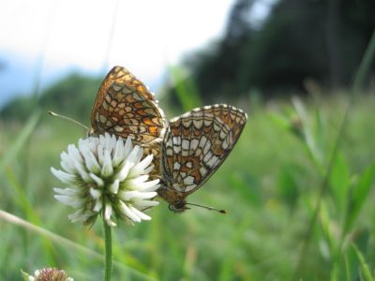

Slide 4
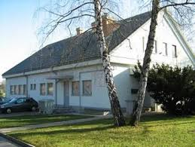
OŠ Šenčur, Podružnična šola TRBOJE KAKO JE 'MAJHNA' PODRUŽNIČNA ŠOLA POSTALA 'VEČJA'

Slide 5
NAJBOLJ NEVARNA BITJA SO …

Slide 6
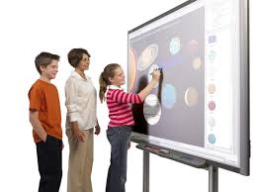
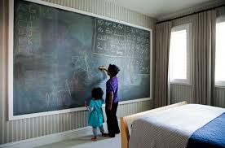
NAVADNA TABLA IN KREDA ALI INTERAKTIVNA TABLA

Slide 7
UREJEN ZVEZEK ali POPLAVA UČNIH LISTOV

Slide 8
Je zvezek popackan, so po njem tacale kure ali je zvezek kar prazen?

Slide 9
Kako motivirati učenca za DN, ko zunaj sonce sije ?

Slide 10
MANJ UČITELJEV V RAZREDU, MANJ UČNIH PREDMETOV, MANJ …
Po mnogih osnovnih šolah razpada organizacija razrednega pouka.

Slide 11
1. MANJ FORMALNEGA ŠOLANJA = VEČ IZBIRE
Less formal schooling = more options
Zakaj je šolanje na Finskem med najbolj učinkovitimi na svetu?

Slide 12
2. MANJ ČASA V ŠOLI = VEČ POČITKA
Less time in school = more rest

Slide 13
3. MANJ UR Z NAVODILI = VEČ ČASA ZA NAČRTOVANJE
Fewer instructions hours = more planning time

Slide 14
4. MANJ UČITELJEV = VEČ DOSLEDNOSTI IN PREDANOSTI
Fewer teachers = more consistency and care
Elementary students in Finland have the same teacher for the first six years. That is right.
* I really believe this is a huge part of Fimland‘s success story and it does not receive enough attention!

Slide 15
5. MANJ SPREJETIH KANDIDATOV = VEČ ZAUPANJA V UČITELJE
Fewer accepted applicants = more confidence in teachers
* So, it isn‘t enough to be the smartest in your class, you also have to have the natural ability and drive to teach.
* Finland understans that the ability to teach is not something that can be gained from studying.
* It is usually a gift and passion that some have it, some don‘t.

Slide 16
6. MANJ UČNIH UR = VEČ ODMORA
Fewer classes = more breaks
* Stagnation of the body leads to stagnation of the brain and unfocused „hyper“ children
* 10 – 20 minutes breaks in between classes
* Teacher‘s room

Slide 17
7. MANJ OCENJEVANJA = VEČ UČENJA
Less testing = more learning

Slide 18
8. MANJ VSEBIN = VEČ GLOBINE
Fewer topics = more depth

Slide 19
9. MANJ DOMAČIH NALOG = VEČ SODELOVANJA, SAMOINICIATIVE
Less homework = more participation

Slide 20
10. MANJ UČENCEV = VEČ INDIVIDUALNE POZORNOSTI
Fewer students = more individual attention

Slide 21
11. MANJ STRUKTUR = VEČ ZAUPANJA
Less structure = more trust
TRUST IS KEY TO THE WHOLE SYSTEM!

Slide 22
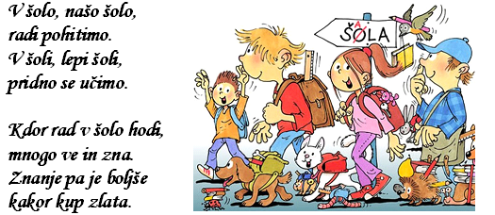

Slide 23
12. MANJ STRESA = VEČ USTVARJALNOSTI
Less stress = more creativity
Saj še velja, da šola vstane in pade z učiteljem!

