Slide 1
The Gingerbread Man
Darja Teran

Slide 2
THE GINGERBREAD MAN
traditional fairy tale
a story that features a gingerbread man who comes to life and runs away.
the original writer of the tale is unknown
the earliest original version of the story in print was published in May 1875 on St. Nicholas Magazine.
Notes:
The Gingerbread Man
“Run, run as fast as you can. You can’t catch me, I’m the gingerbread man.”
The Gingerbread Man is one of the classic stories for children which was first read in the May 1875 issue of St. Nicholas Magazine. It tells about a boy-patterned bread which surprisingly gains life and tries to escape from the hot oven. He is chased after by a couple and several animals who want to eat him. He is eventually deceived and swallowed by a cunning fox.
Nowadays, children who haven’t heard the story yet recognize the main character as Gingy, one of Shrek’s friends. In the movie, he has traits similar to the classic story as well. He is small and a fast runner too. He’s scared of Santa because he ate his girlfriend.
This run-away food plot has plenty of versions. In most storybooks and videos, those who are chasing after him are animals. But in the version of Paul Galdone, farm workers track him too. Most resources also end up in the river, where the Gingerbread Man is tossed and gobbled by the fox while swimming to the other side. However, the video of Speekaboos.com below has a different twist

Slide 3
THE STORY

Slide 12
ACTIVITIES
Animals
Counting
Colours
Shapes
Body parts
Spices
House

Slide 13
The Gingerbread Man‘s Songs

Slide 14
Five Yummy Gingerbread

Slide 15
Five Little Gingerbread Men
Five little Gingerbread Men jumping on the bed.
One runs away and he is red.
Four little Gingerbread Men eating jello.
One runs away and he is yellow.
Three little Gingerbread Men acting mean.
One runs away and he is Green
Two little Gingerbread Men about to fall down.
One runs away and he is brown.
One little Gingerbread Man looking at you.
He runs away and he is blue.

Slide 16
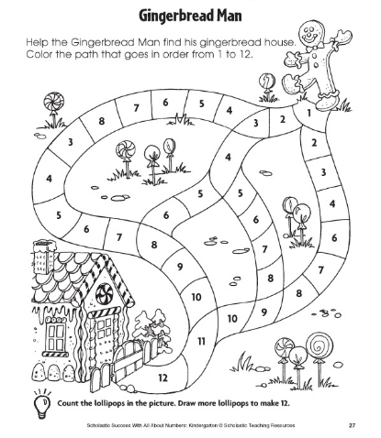
Numbers from 1 to 12

Slide 17
Colours and numbers

Slide 18
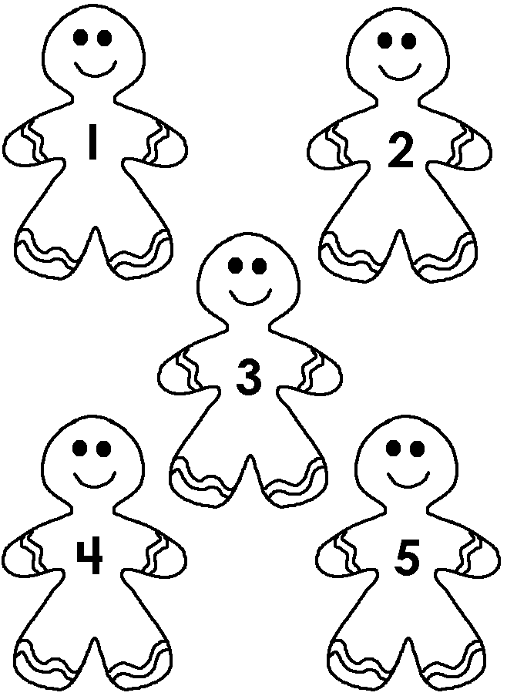
Matching

Slide 19
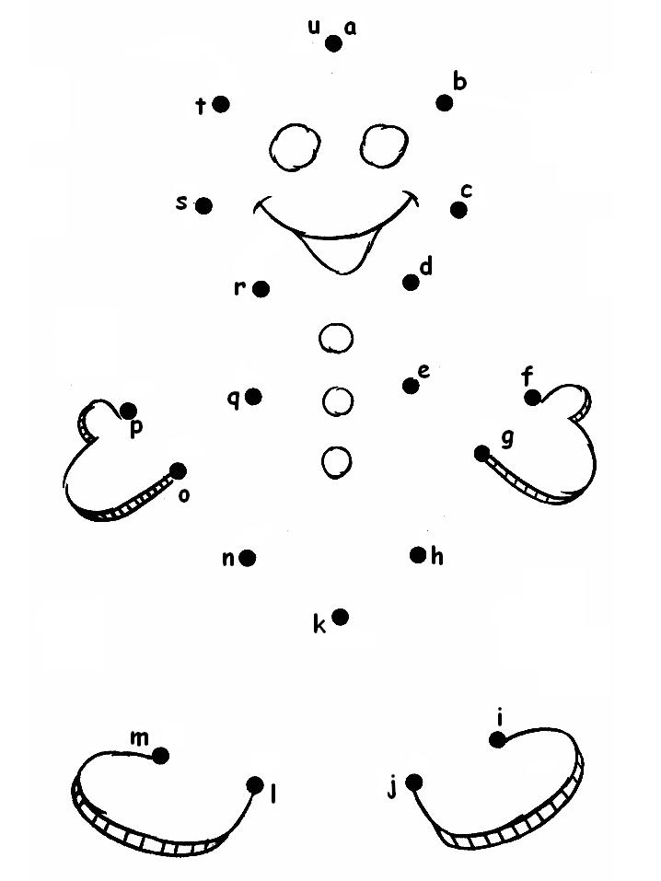
Connecting The Dots

Slide 20
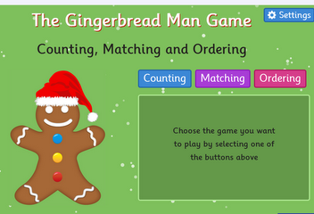
Counting, matching and ordering
http://www.topmarks.co.uk/learning-to-count/gingerbread-man-game
Notes:
About The Gingerbread Man Game
The Gingerbread Man Game includes counting, matching and ordering numbers games aimed at children who are learning to count and recognise the numbers and number words up to 10.
Designed to offer differing levels of difficulty these four fun games, all with a Gingerbread Men theme, give children opportunities to:
Count the buttons on a gingerbread man.
Put a specified number of buttons on a gingerbread man.
Count buttons on gingerbread men up to 10 and match each gingerbread man to a number.
Order gingerbread men from either smallest to largest or largest to smallest depending on their number of buttons.
All these counting and ordering numbers games are suitable for use on computers or tablets, in the classroom or home. Questions are randomly generated so that children can play the games repeatedly.

Slide 21
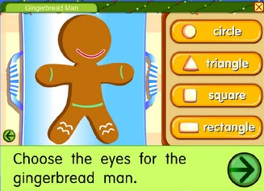
Shapes and body parts
http://www.starfall.com/n/holiday/gingerbread/play.htm?f

Slide 22
Finger Puppets

Slide 23
Body Parts – Roll and Draw a Gingerbread Man

Slide 24
Clothes

Slide 25
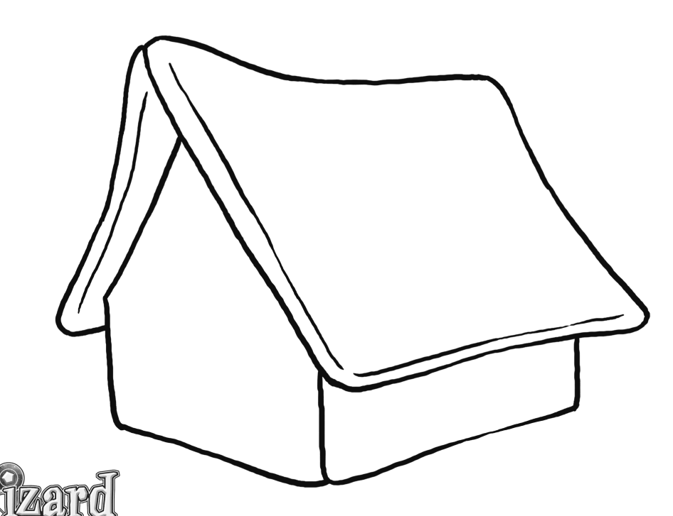
Gingerbread Man‘s House

Slide 26
Gingerbread Biscuits (for 10 biscuits)
½ cup plain flour
½ teaspoon of ginger powder
¼ margarine or butter
¼ castor sugar
½ an egg or milk to mix
a few currants
Sieve the flour and ginger. Rub in the fat until the mixture has the texture of breadcrumbs. Roll out the mixture and cut out shapes of gingerbread people. Use currants for eyes and months. Bake on trays for 12 or 15 minutes at 180 degrees C.

Slide 27
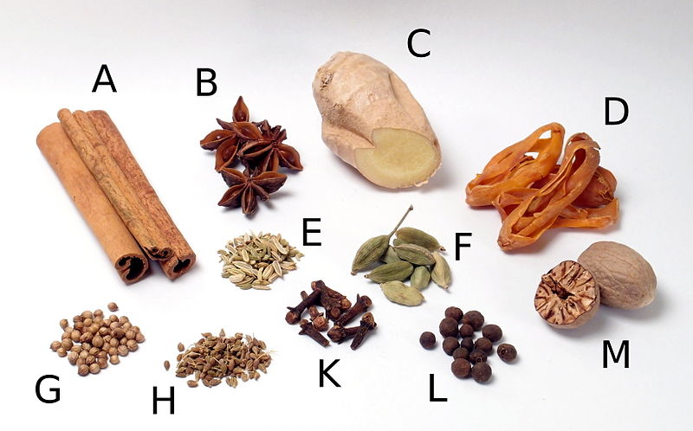
Spices
A: cinnamon
B: star aniseed
C: ginger
D: mace
E: fennel seeds
F: green cardamom
G: coriander
H: aniseed
K: cloves
L: allspice
M: nutmeg

Slide 28
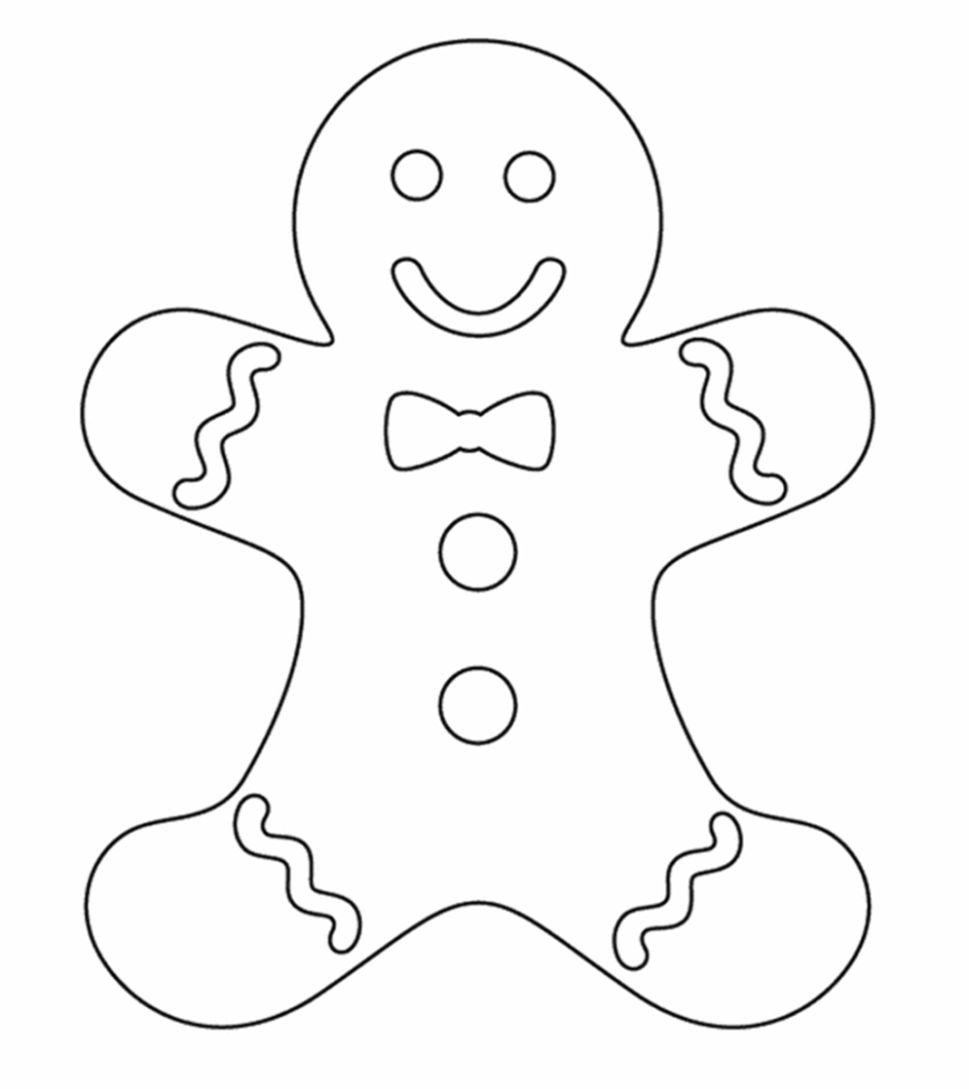
Colour Your Gingerbread Man

Slide 29
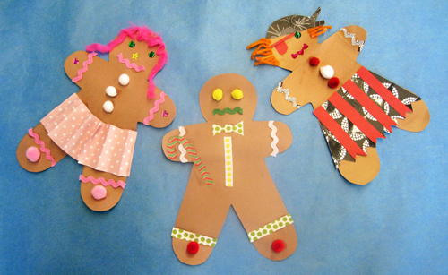
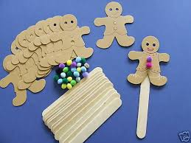
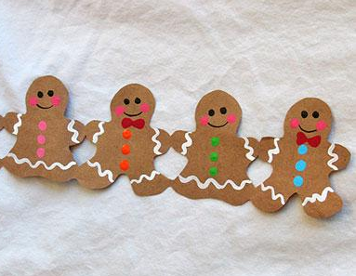
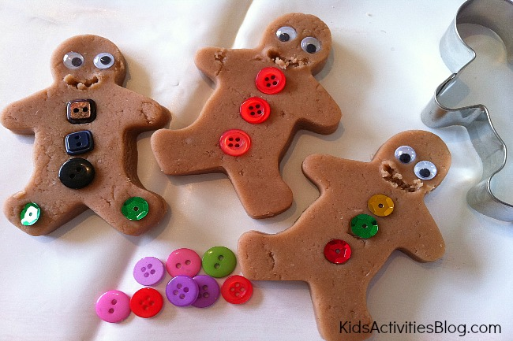
Crafts

Slide 30
The Gingerbread Man run

Slide 31
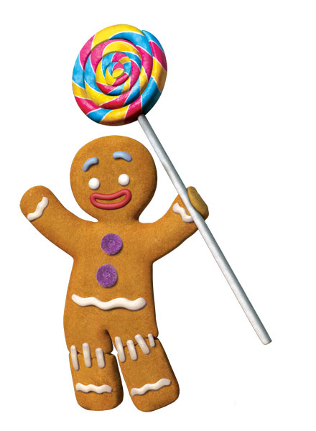
Listening and watching the story
http://www.speakaboos.com/story/the-gingerbread-man
http://www.youtube.com/watch?v=FpBJih02aYU

