Slide 1
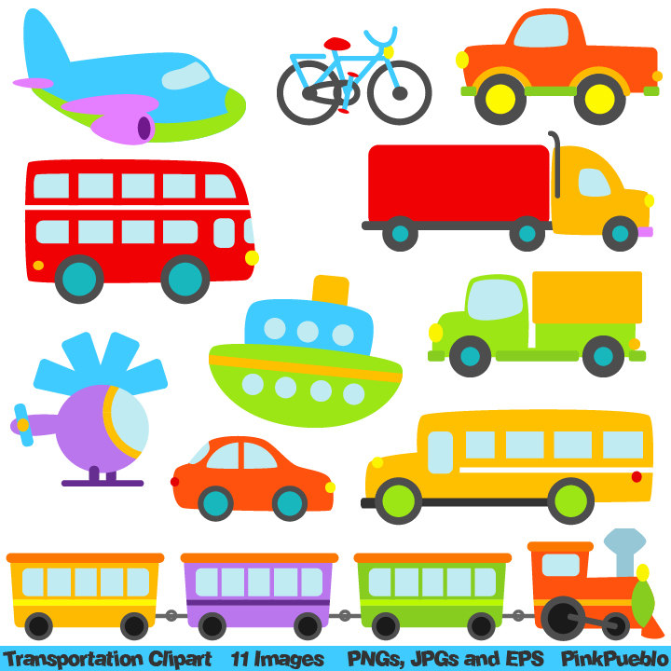
Transportation and Vehicles

Slide 2
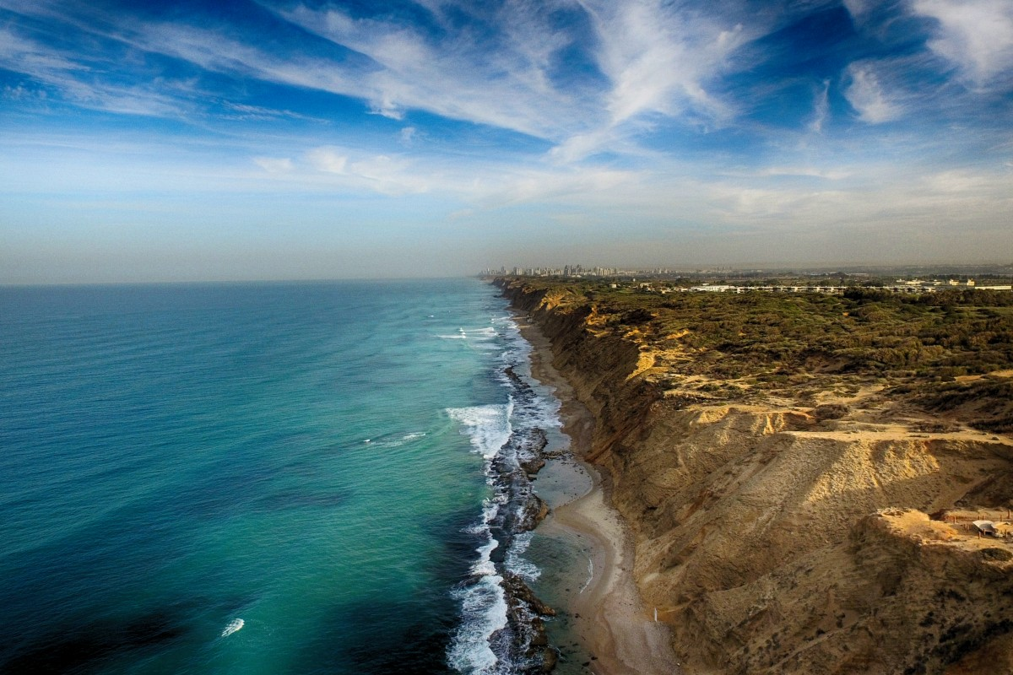
Travel
Sky
Land
Water

Slide 3
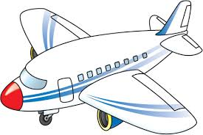
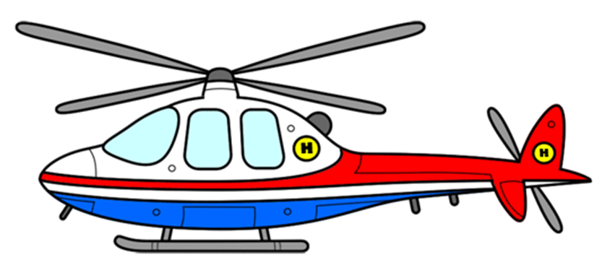
Travel in the sky
Airplane
Helicopter
He usually travels through/across the sky to ______.

Slide 4
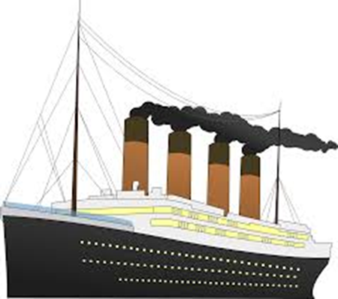
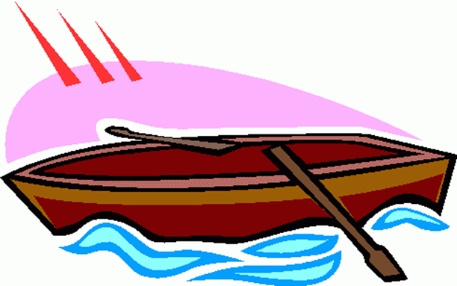
Travel on water
Boat
Ship
Some people travel on water to _____.

Slide 5
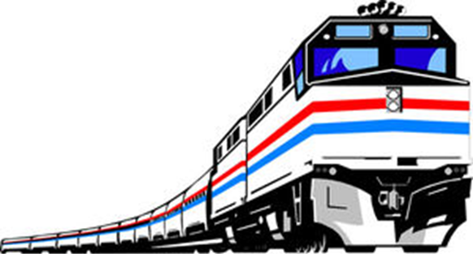
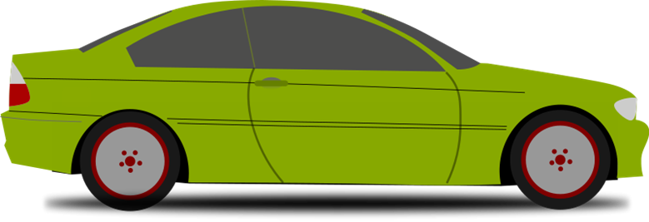
Travel on land
Car
Train
They often travel on/by land to _____.

Slide 6
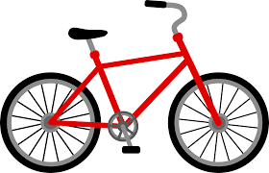
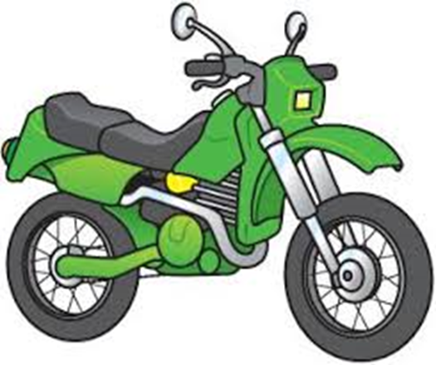
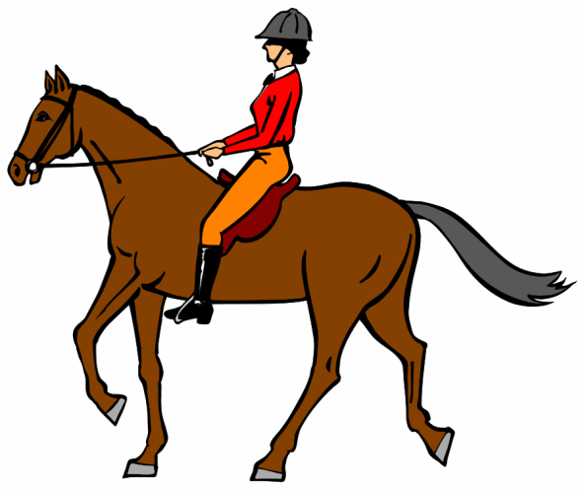
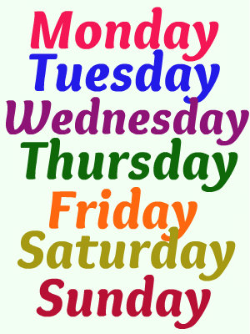
Ride
Bicycle/Bike
Motorcycle/Bike
Horse
I like to ride the _____ on ______.

Slide 7
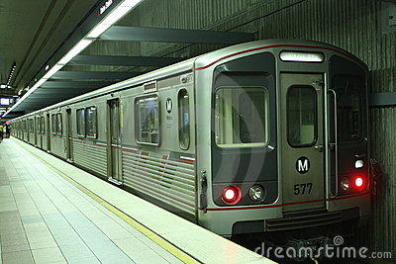
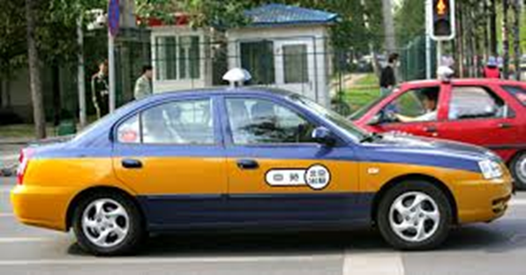
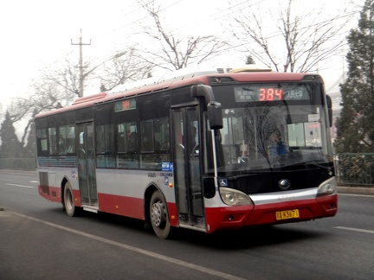
Take
Subway
Taxi/Cab
Bus
I take the _____ to the city on _____.

Slide 8
How do you go to School?
I walk to school sometimes/every day.
I go to school on foot sometimes/every day.
I go to school by ____ sometimes/every day.
I take the ___ to school sometimes/every day.

