Slide 1
GARDEN

Slide 2
VEGETABLES

Slide 3
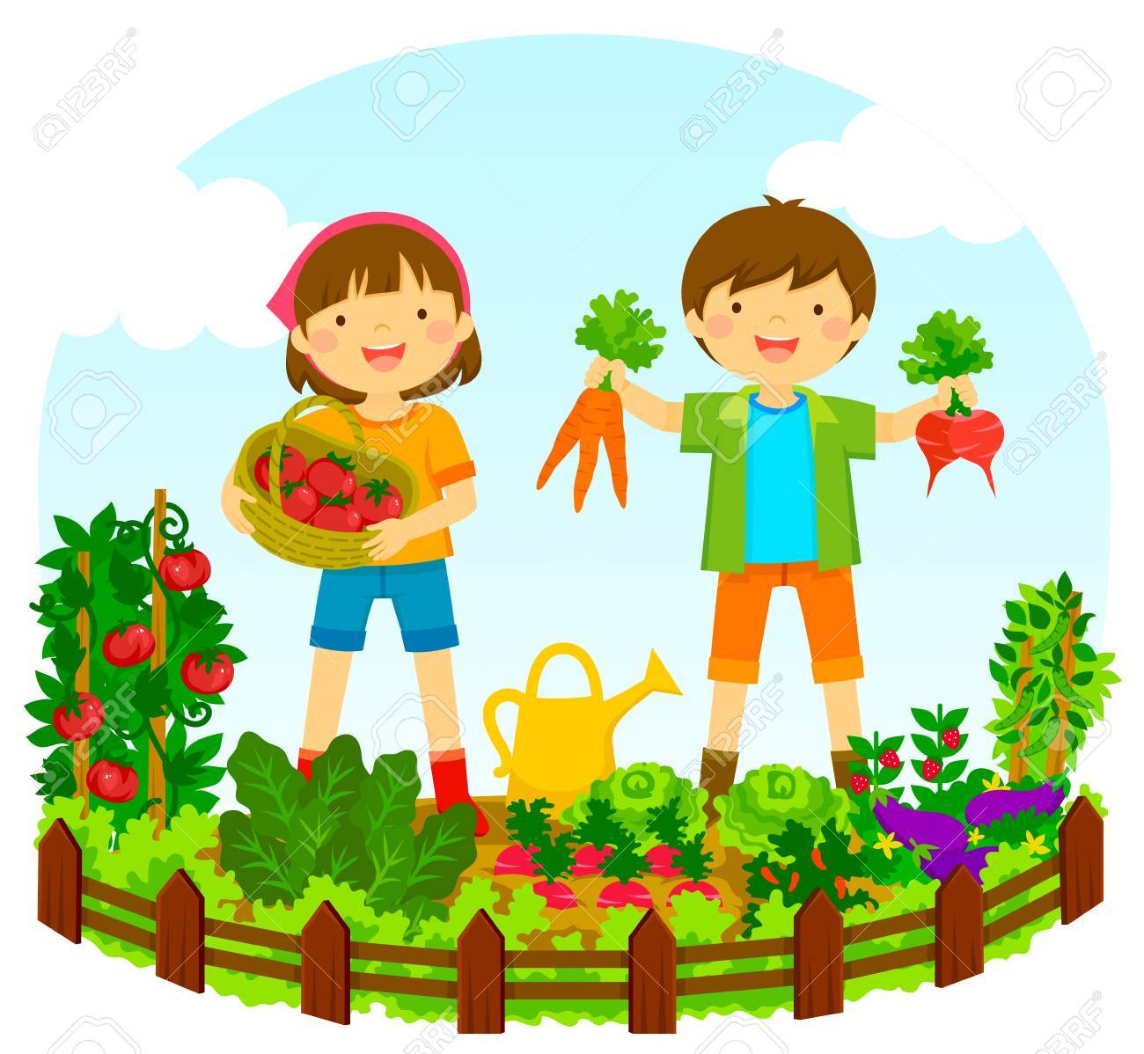
VEGETABLE
GARDEN

Slide 4
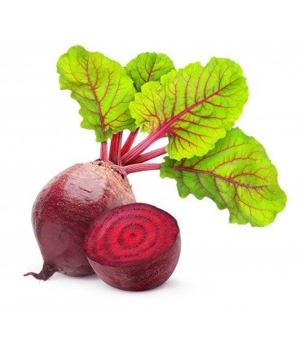
BEET
Notes:
BEET

Slide 5
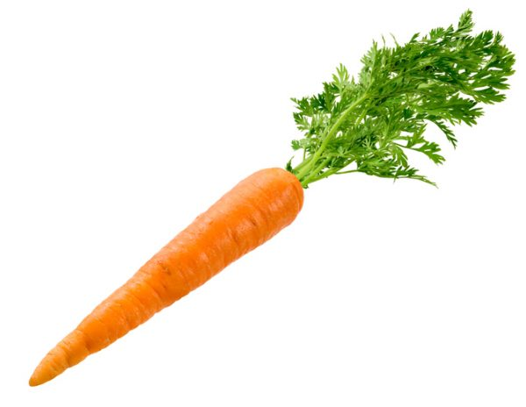
CARROT
Notes:
CARROT

Slide 6
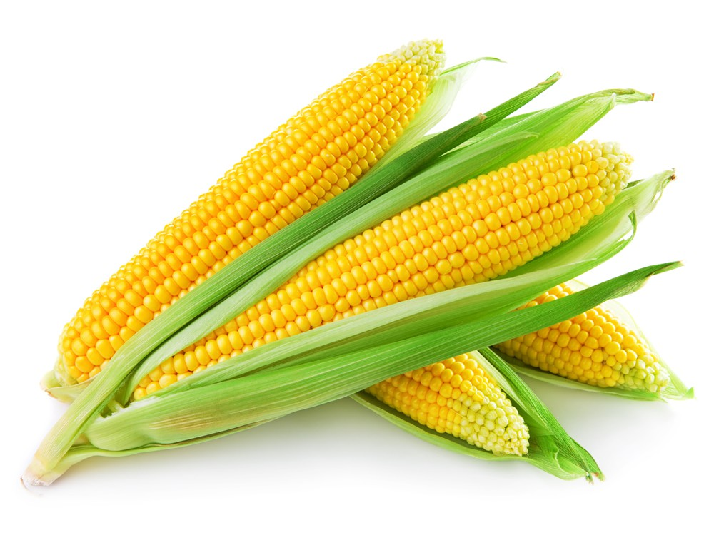
CORN
Notes:
CORN

Slide 7
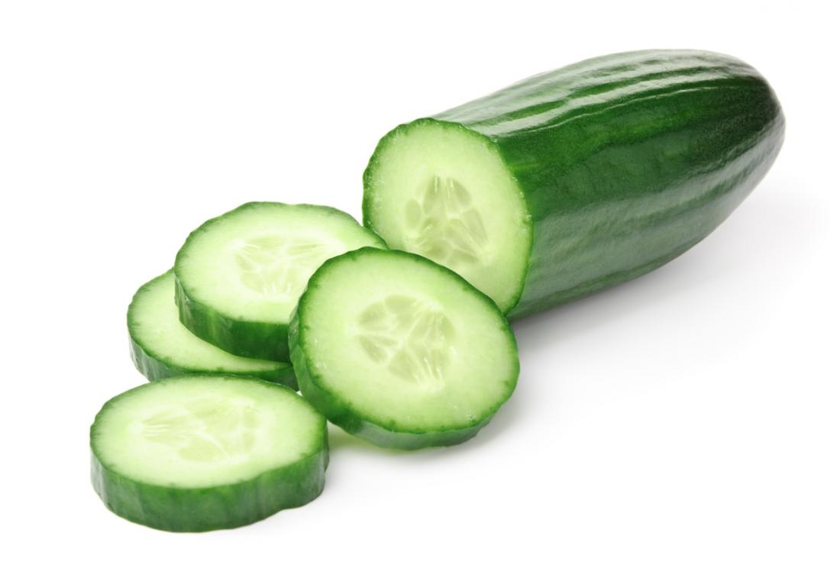
CUCUMBER
Notes:
CUCUMBER

Slide 8
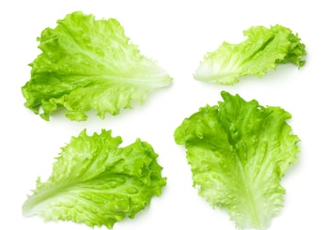
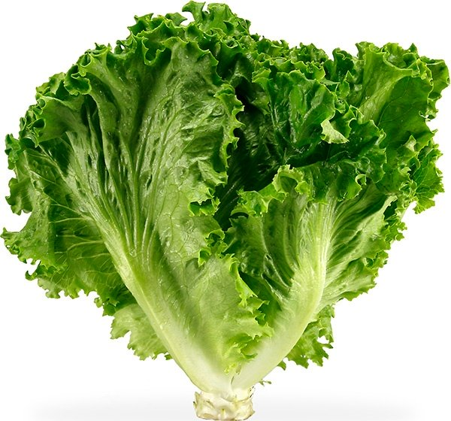
LETTUCE
Notes:
LETTUCE

Slide 9
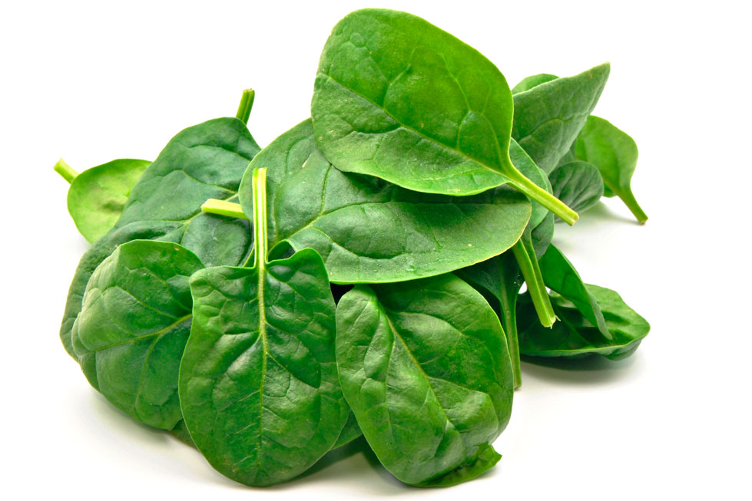
SPINACH
Notes:
SPINACH

Slide 10
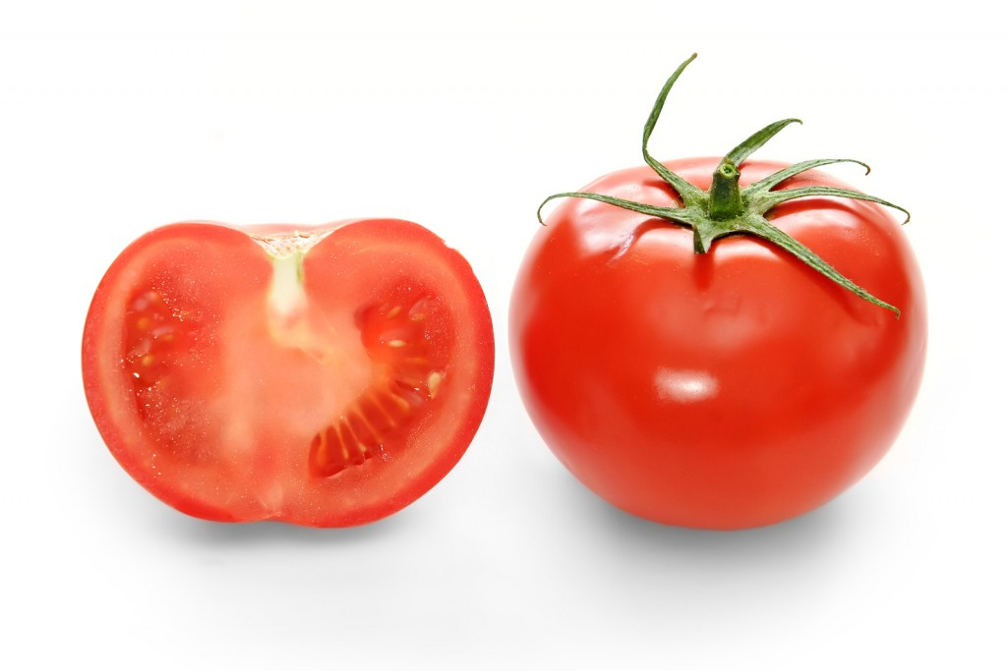
TOMATO
Notes:
TOMATO

Slide 11
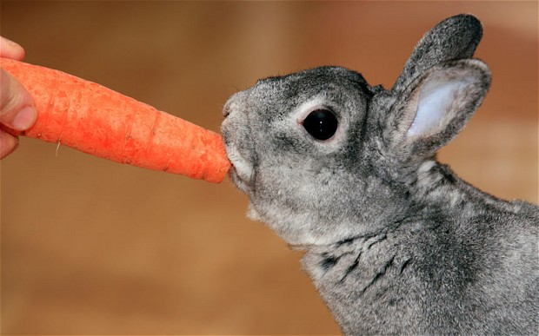
BUNNIES EAT CARROTS.

Slide 12
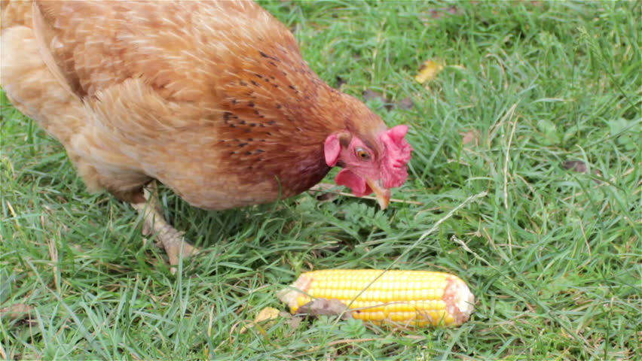
CHICKENS EAT CORN.

Slide 13
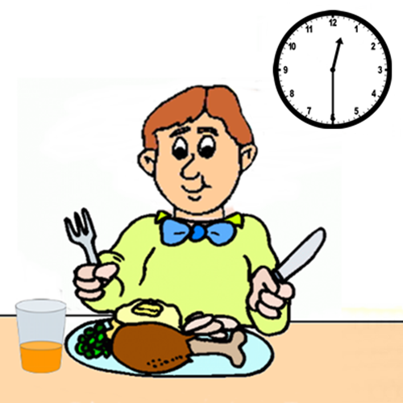
LUNCH

Slide 14
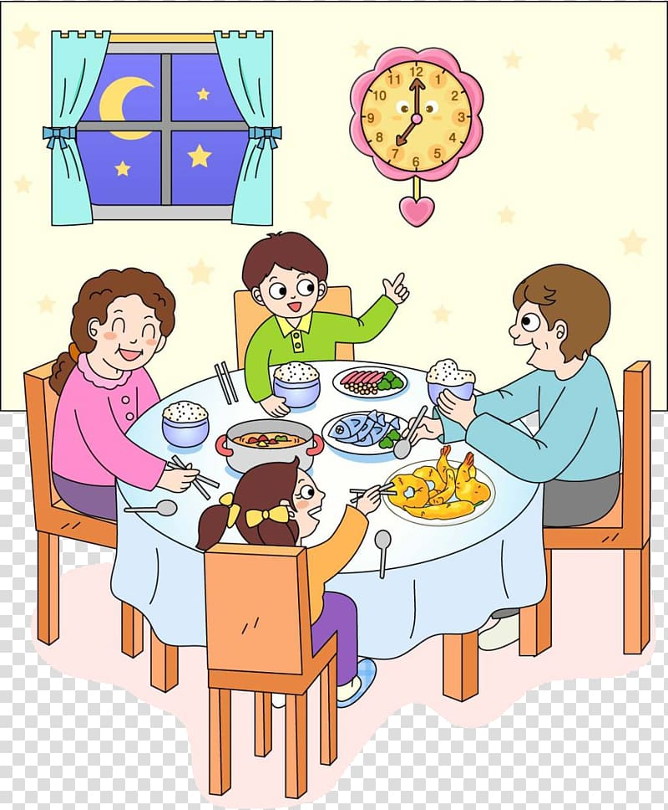
DINNER

Slide 16
EBTE
Notes:
BEET

Slide 17
RCRAOT
Notes:
CARROT

Slide 18
NOCR
Notes:
CORN

Slide 19
CECRUMUB
Notes:
CUCUMBER

Slide 20
TUTCELE
Notes:
LETTUCE

Slide 21
PACNISH
Notes:
SPINACH

Slide 22
OTOMTA
Notes:
TOMATO

Slide 24
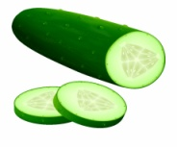
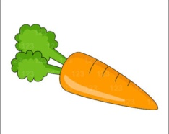
V | E | G | E | T | A | B | L | E |  | G | A | R | D | E | N

Slide 25
 |  |  |  |  |  |  |  | C
 |  |  |  |  |  |  |  | U
 |  |  |  |  |  |  |  | C
 |  |  |  | L | T |  |  | U |  |  |  |  |  |  | S
 |  |  |  | E | O |  |  | M |  |  |  | C |  |  | P
 | B |  |  | T | M |  |  | B |  |  | C | O |  |  | I
V | E | G | E | T | A | B | L | E |  | G | A | R | D | E | N
 | E |  |  | U | T |  |  | R |  |  | R | N |  |  | A
 | T |  |  | C | O |  |  |  |  |  | R |  |  |  | C
 |  |  |  | E |  |  |  |  |  |  | O |  |  |  | H
 |  |  |  |  |  |  |  |  |  |  | T

Slide 26
A | C | E | F | H | J | L | N | P | N | R | O | C
T | H | C | A | R | R | O | T | Q | S | T | V | W
G | C | G | I | K | M | O | P | R | D | B | B | S
X | A | R | E | B | M | U | C | U | C | O | E | Y
B | N | U | O | Q | I | E | D | X | I | M | E | Z
A | I | E | T | O | M | A | T | O | G | S | T | N
E | P | R | I | D | L | S | R | P | A | W | N | K
O | S | Y | V | E | C | U | T | T | E | L | B | A

Slide 27
A | C | E | F | H | J | L | N | P | N | R | O | C
T | H | C | A | R | R | O | T | Q | S | T | V | W
G | C | G | I | K | M | O | P | R | D | B | B | S
X | A | R | E | B | M | U | C | U | C | O | E | Y
B | N | U | O | Q | I | E | D | X | I | M | E | Z
A | I | E | T | O | M | A | T | O | G | S | T | N
E | P | R | I | D | L | S | R | P | A | W | N | K
O | S | Y | V | E | C | U | T | T | E | L | B | A

Slide 29
HAVE FUN MAKING UP SENTENCES!
CHICKENS |  | LIKE |  | BEET FOR DINNER
BUNNIES |  | EAT |  | CARROTS
I |  | LOVE |  | BEAUTIFUL
MY FRIENDS |  | HAVE |  | LETTUCE
SPINACH |  | PLANT |  | CORN
ROSES |  | SMELL |  | SALAD FOR LUNCH
WE |  | IS |  | GREEN
SOUP |  | ARE |  | DELICIOUS

