Slide 1
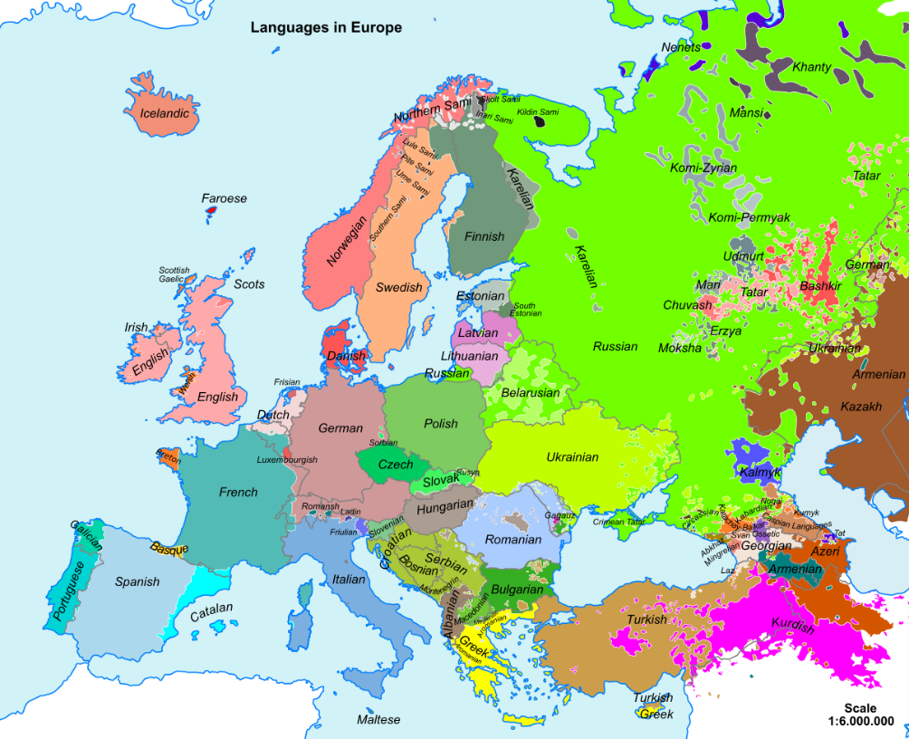
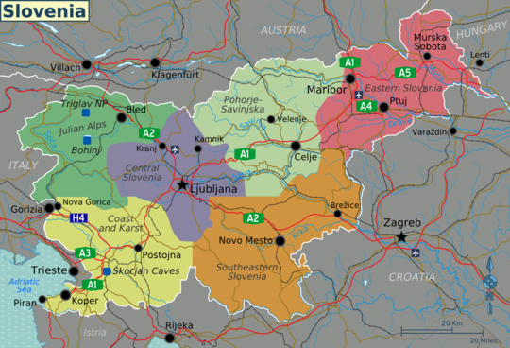
Europe Slovenia
3.a: 57., 3.d: 56., 57.
Week: 34.
Teacher: Jolanda Regouc

Slide 2
Europe Listen:
It‘s the second smallest continent in size. Je drugi najmanjši kontinent po velikosti.
It‘s the third largest continent in population. Je tretji največji kontinent po številu prebivalcev.
There are fifty countries in the Europe continent. V Evropi je 50 držav.
There are twenty-seven nations in the European Union. V Evropski Uniji je 27 držav.
There live 742 million people in Europe. V Evropi živi 742 milijonov ljudi.
Europe borders onto the Arctic Ocean in the north, the Atlantic Ocean in the west and the Mediterranean Sea in the south. Evropa na severu meji na Arktični ocean, na zahodu na Atlantski ocean in na jugu na Mediteransko morje.
Remember:in the northna severu, in the westna zahodu, in the southna jugu

Slide 3
Europe Countries Listen:
There are 50 countries in Europe.
The three largest countries are: Russia, the Ukraine, France.
Vatican City is the smallest country in Europe.
Greenland is the largest island in Europe.
Hum in Croatia is the smallest town in Europe.
Moscow is the largest town in Europe.

Slide 4
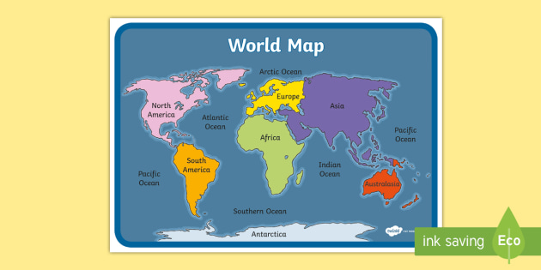
World Map Find out Europe

Slide 5
Europe Map Find out Slovenia, Croatia, Italy and Hungary

Slide 6
Slovenia in Europe

Slide 7
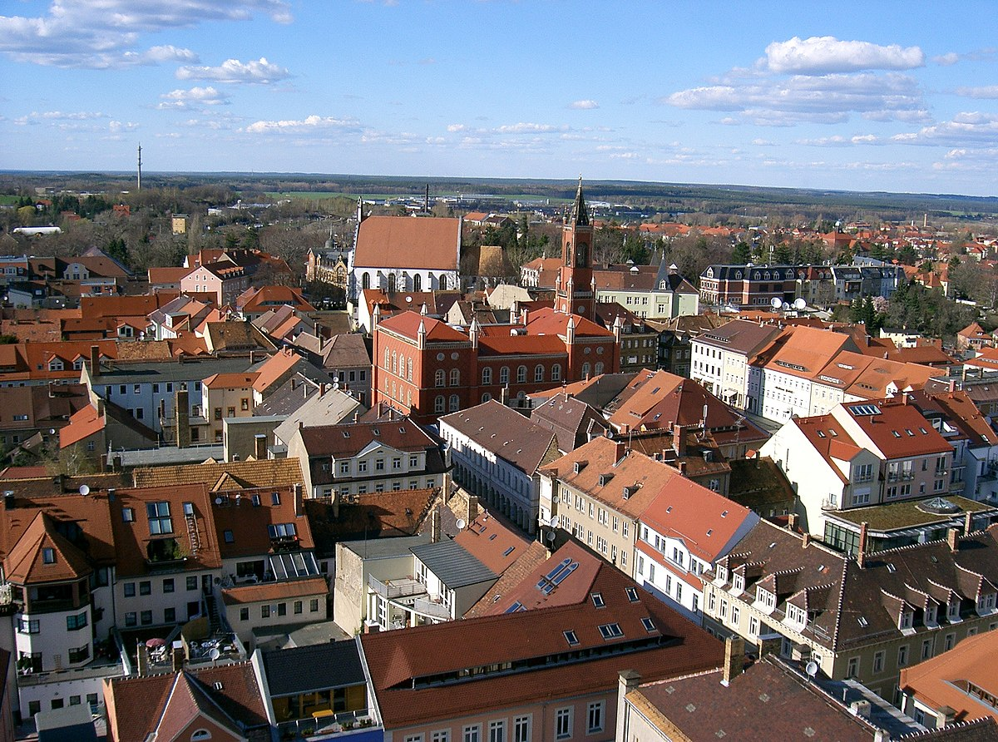
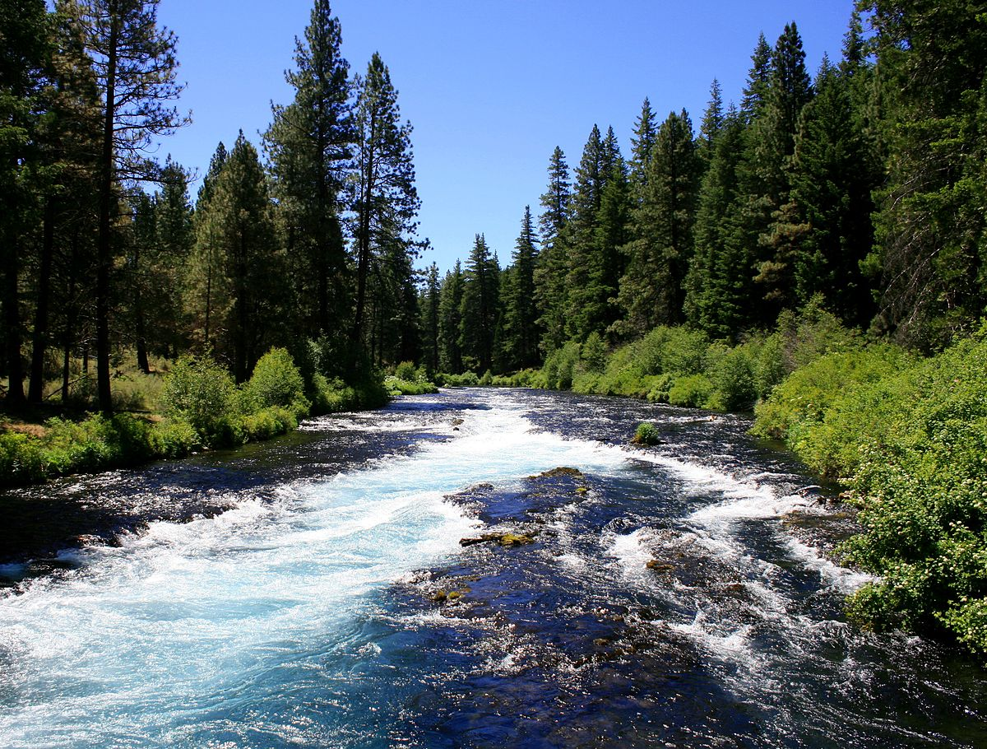
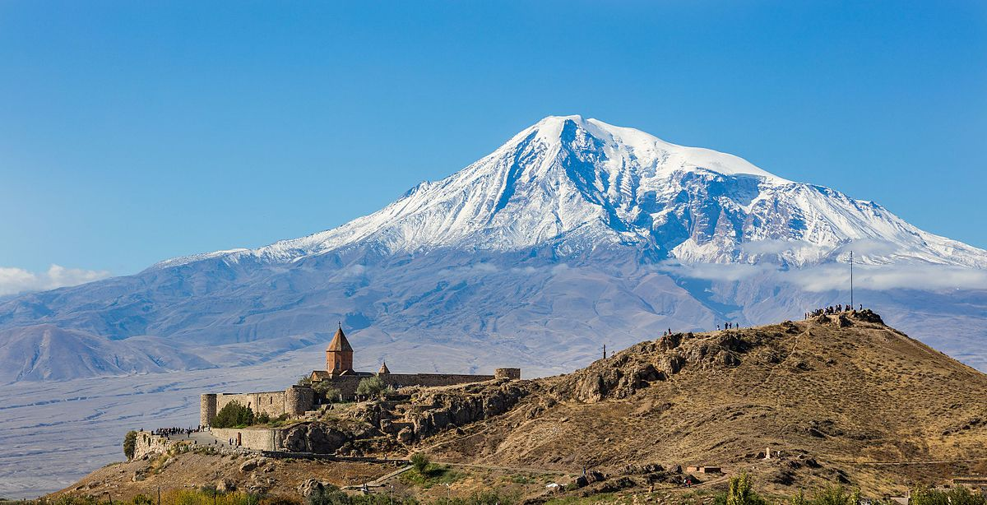
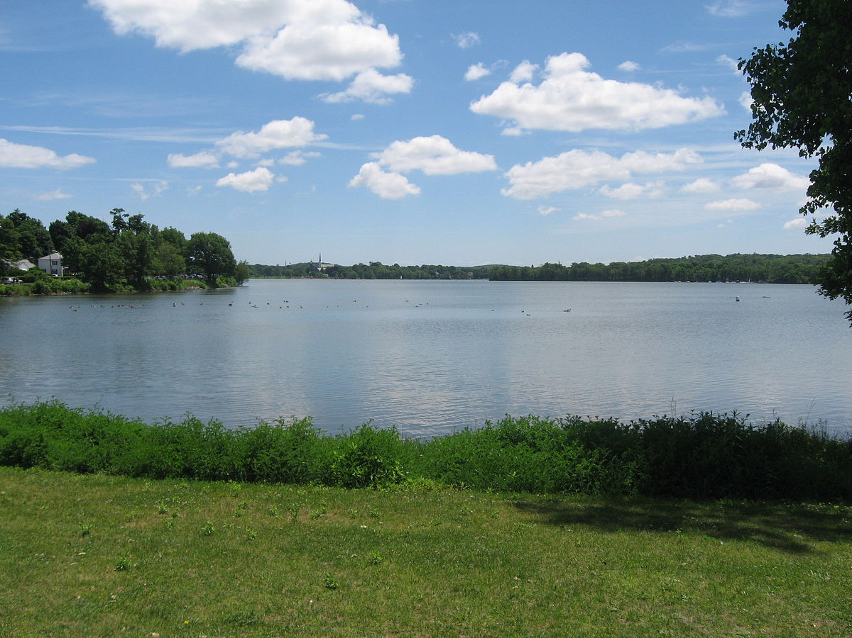
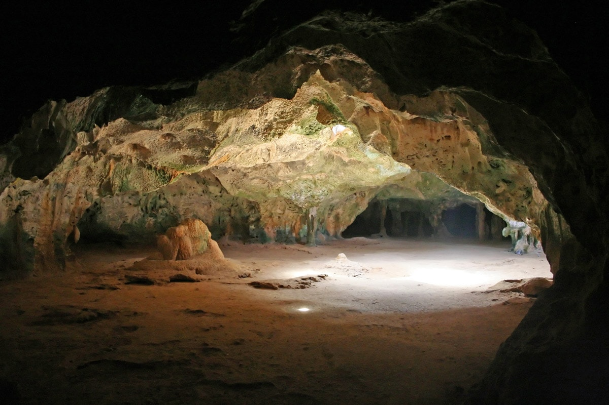
My country Slovenia Listen:
Slovenia is a small and very beautiful country. Slovenija je zelo majhna in lepa dežela.
It‘s got many interesting things to see. Za ogled ima veliko zanimivosti.
There are lots of different towns, rivers, mountains, lakes and caves. V Sloveniji je veliko različnih mest, rek, gora, jezer in jam.
It‘s in the south central Europe. Je na jugu centralne Evrope.
Its neighbours are Italy, Austria, Croatia and Hungary. Njene sosede so Italija, Austrija, Hrvaška in Madžarska.
Remember: a town, a river, a mountain, a lake, a cave.

Slide 8
Slovenia map Cities in Slovenia

Slide 9
I feel Slovenia Listen: Slovenia is the 10th best country in Europe Slovenija je deseta najbolj priljubljena država v Evropi.
Best places to see in Slovenia are: Ljubljana, Maribor, Piran, Bled… Najboljši kraji za ogled v Sloveniji so:
Ljubljana: It‘s the capital city in Slovenia. There live about 250 000 people. It‘s very charming old town. Je glavno mesto v Sloveniji. Tam živi okoli dvestopetdest tisoč ljudi. Je zelo privlačno staro mesto.
Maribor: It‘s the second largest city in Slovenia near river Drava. Je drugo največje mesto v Sloveniji ob reki Dravi.
Piran: It‘s an old mediterranian town with narrow streets and nice squares. Je staro mediteransko mesto z ozkimi ulicami in lepimi trgi.
Bled: It‘s a fairytale place with its lake, island and its castle above the lake. Je pravljično mesto z njegovim jezerom, otokom in njegovim gradom nad jezerom.
Postojna Cave and Skocjan caves are world famous caves. Postojnska jama in Škocjanske jame so svetovno znane jame.
Remember: a capital city/glavno mesto, a river/reka, narrow streets/ozke ulice, a square/trg, a fairytale/pravljica, a lake/jezero, an island/otok, a castle/grad, above/nad, near/zraven, a cave/jama

