Slide 1
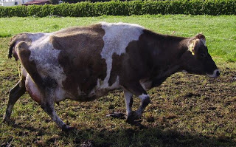
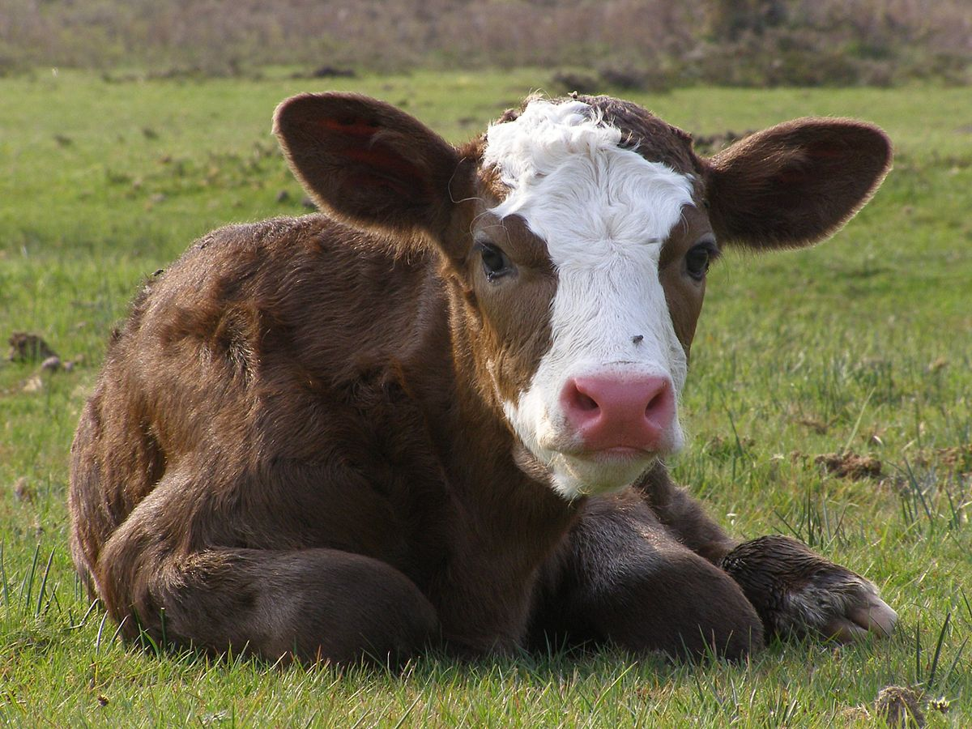
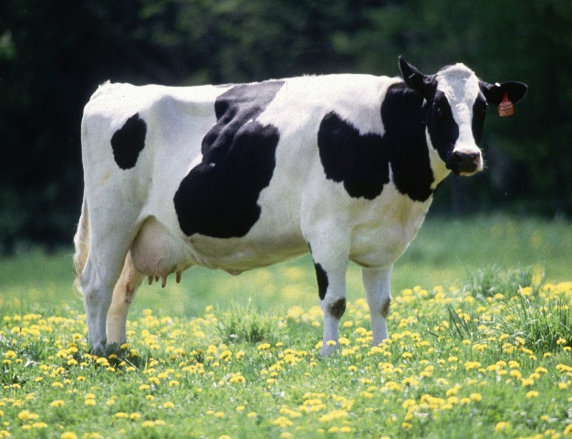
FARM ANIMALS SPRING, FOOD
A cow
2.ad
Month: MAY Week: 37.
Teacher: Jolanda Regouc
A calf

Slide 2
SPRING POMLAD LISTENPOSLUŠAJ: READ BERI
Storks and swallows return from Africa.
Birds build nests and lay eggs.
Nestlings hatch from their eggs.
Insects come out.
Animals wake up from their winter sleep.
Trees come into buds.
New leaves appear. Cherry blossoms, flowers bloom.
Seeds sprout. Crops grow. Farmers plough the fields up.
People dig, hoe, rake, sow seeds, plant tomatoes in their gardens.

Slide 3
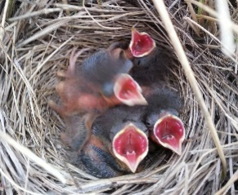
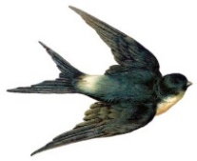
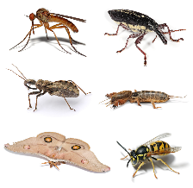
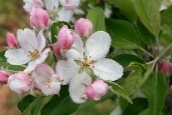
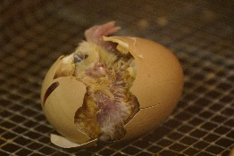
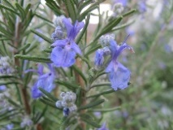
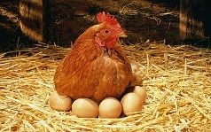
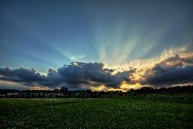
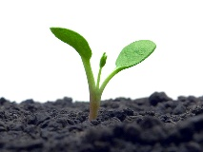
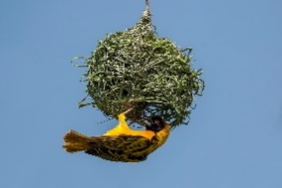
SPRING POMLAD
KEY WORDS KLJUČNE BESEDE
Listen: Repeat
nestlings
A stork
A swallow
insects
A cherry
To blossom
To hatch
To bloom
To lay eggs
To appear
A sprout
A bird build a nest.

Slide 4
SPRINGPOMLAD REPEAT PONOVI LISTENPOSLUŠAJ:
C:\Users\HP\Documents\2019 20\Home TJA\2.r\FARM ANIMALS\SPRING KEY WORDS 2.docx
WRITE. NAPIŠI Draw your favourite word. Nariši tvojo najljubšo besedo.
a stork - a cherry
a swallow - to blossom
a nest - to bloom
a nestling - insects
to return - to appear
to build - to sprout
to hatch - a field

Slide 5
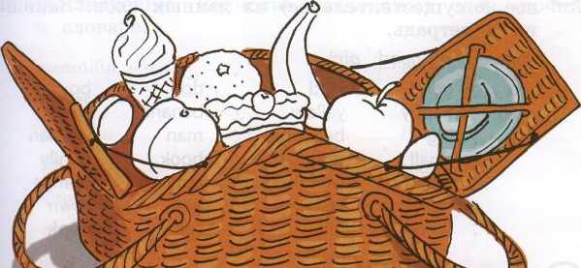
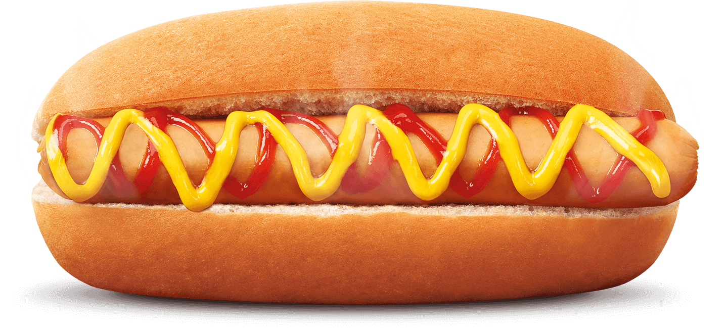
FOOD REPEAT LISTEN:
1. Read and colour the food.
1 a yellow banana
2 a red apple
3 an orange orange
4 a pink peach
5 a brown cake
6 chocolate ice cream
7 a white egg
8 a purple plum
2. Add a or an. Dodaj a ali an
1 a banana 6 ___ hotdog
2 ___ apple 7 ___ sandwich
3 ___ orange 8 ___ strawberries
4 ___ eggs 9 ___ egg
5 ___ toast 10 ___ potato
A hotdog

Slide 6
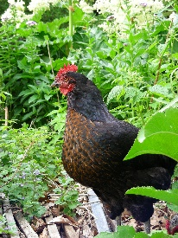
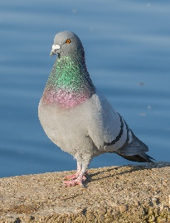
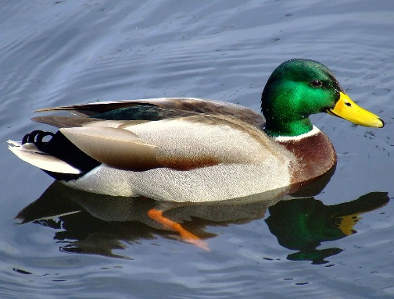
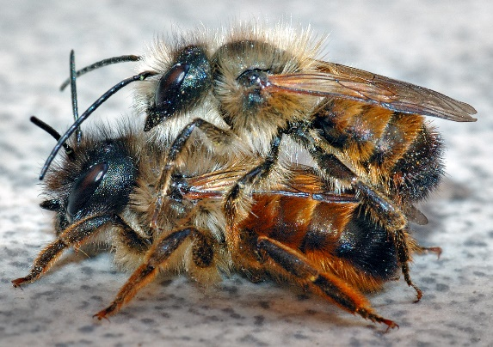
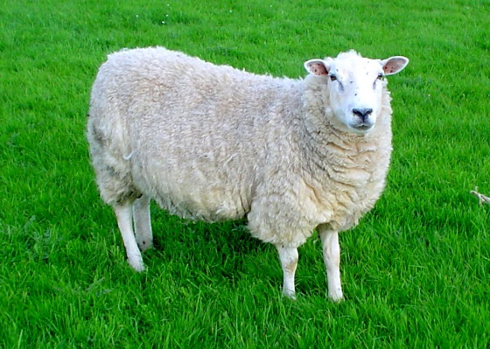
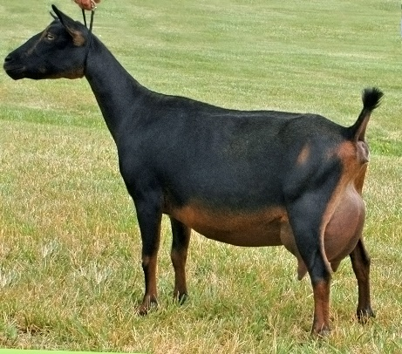
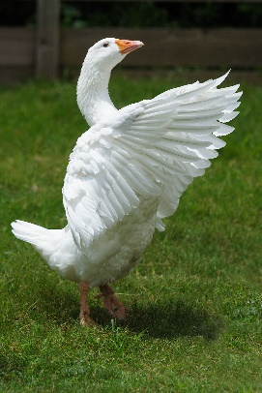
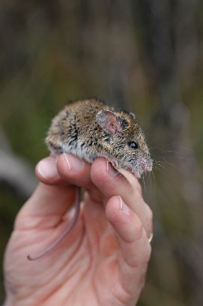
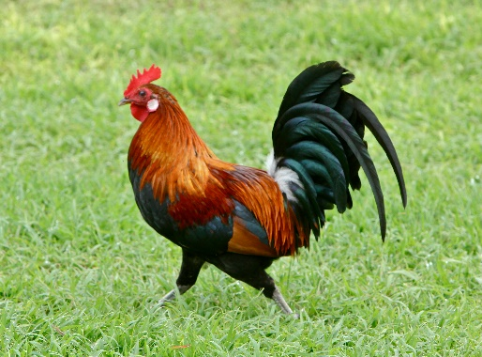
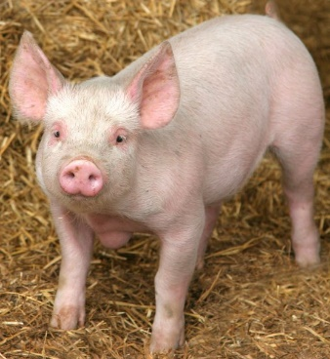
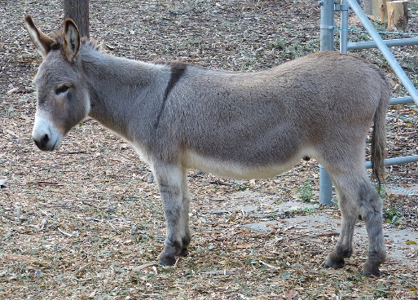
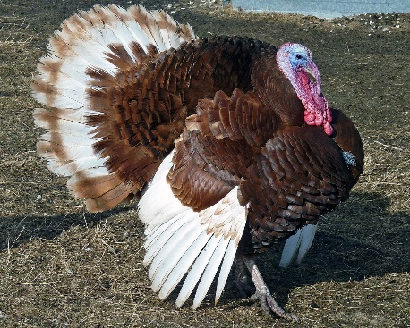
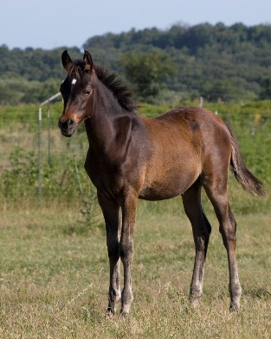
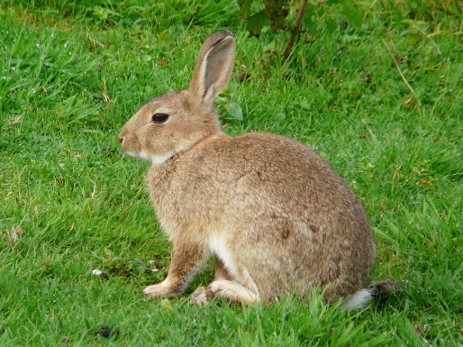
FARM ANIMALS Listen:
A hen
A pigeon
Write.Napiši FARM ANIMALS ARE:
A cow, a horse, a sheep, a goat, a donkey, a pig, a turkey, a goose,
a duck, a rabbit, a hen, a rooster, a cat, a dog, a mouse, a pigeon, bees…

Slide 7
FARM ANIMALS What animal is this? Let‘s watch the video!

Slide 8
Old Mac Donald had a farm a pig, a duck, a horse, a cow, a turkey oink oink, quack quack, neigh neigh, moo moo, gobble gobble
Old Mac Donald had a farm, E-I-E-I-O!
And on that farm he had a pig, E-I-E-I-O!
With an oink oink here!
And an oink oink there!
Here an oink, there an oink,
Everywhere an oink oink!
Old Mac Donald had a farm, E-I-E-I-O!
Old Mac Donald had a farm, E-I-E-I-O!
And on that farm he had a duck, E-I-E-I-O!
With a quack quack here!
And a quack quack there!
Here a quack, there a quack,
Everywhere a quack quack!
Old Mac Donald had a farm, E-I-E-I-O!

