Slide 1
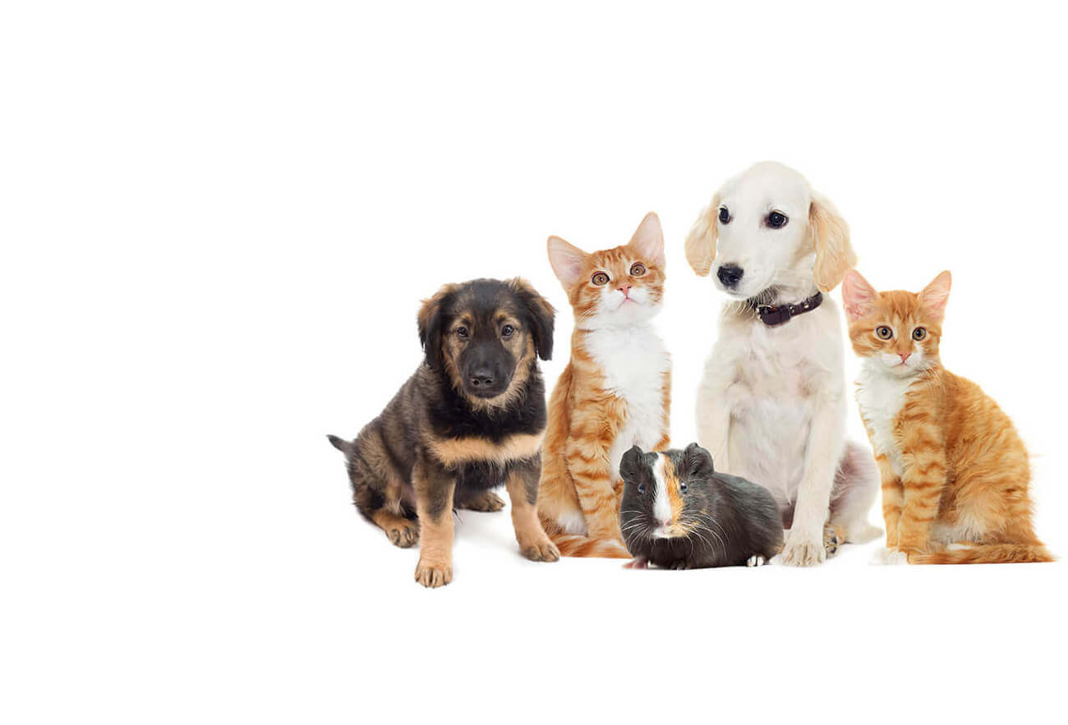
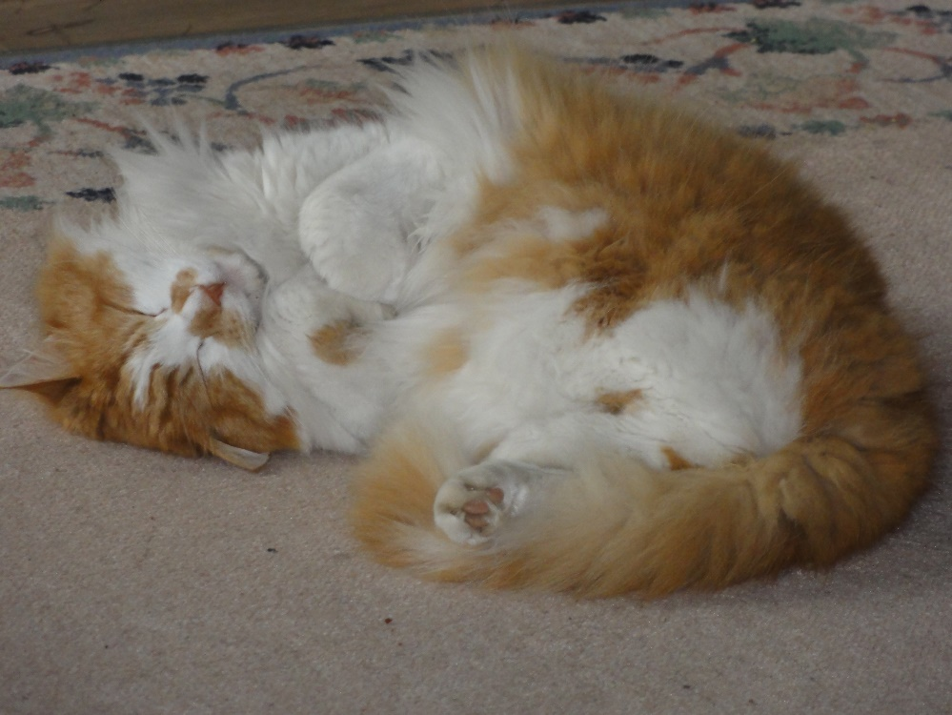
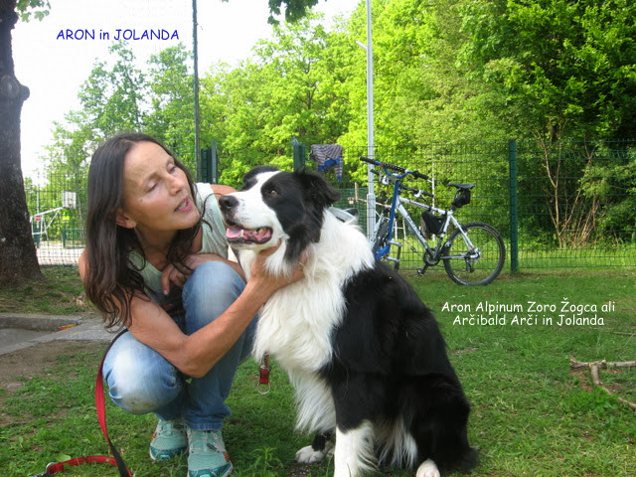
PETS
1.B, 1.D
MAY
TEACHER JOLANDA REGOUC

Slide 2
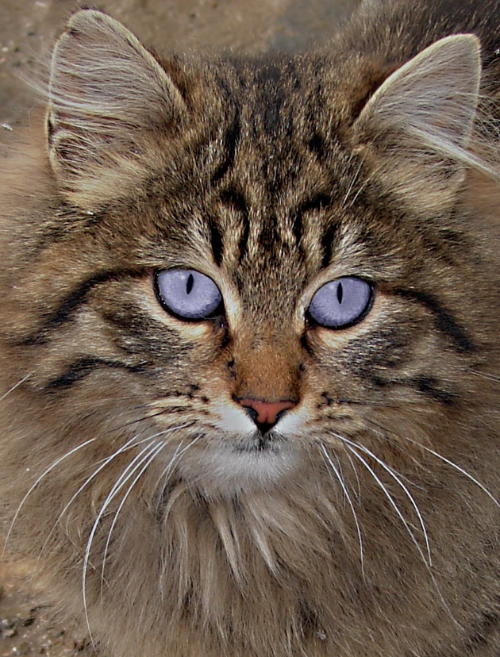
WHO IS A PET? LISTEN:
A PET IS AN ANIMAL, THAT LIVES WITH YOU.
A PET IS AN ANIMAL, THAT LIVES WITH YOU IN YOUR HOUSE.
A PET IS AN ANIMAL, WHO YOU LIKE IT.
A PET IS AN ANIMAL, WHO IS YOUR FRIEND.
A PET IS YOUR BEST FRIEND.
I LOVE MY PETS.
THERE ARE HOUSE PETS: A DOG, A CAT, A FISH, A PARROT,
A HAMSTER, A RABBIT, A CANARY, AN IGUANA, A TURTLE,
A CHAMELEON…

Slide 3
HOUSE PETS LISTEN:
THE DOG IS A MAN‘S BEST FRIEND.
THE CAT CHASES LITTLE THINGS AWAY.
THE HAMSTER IS AN ACTIVE PET.
THE CHAMELEON IS A PET, THAT CAN CHANGE COLOURS.
THE TURTLE IS A SLOW PET.
A FISH TANK IS SO MUCH FUN TO WATCH.
PARROTS CAN SAY PEOPLE WORDS.
THE SNAKE IS A SMOOTH PET.
THE RABBIT IS A SOFT PET.

Slide 4
DO YOU HAVE A PET? YES, I HAVE A DOG. LISTEN:
I HAVE A PET. HE IS A DOG. AND HE SAYS ‘FOOF FOOF FOOF… I HAVE A PET. SHE IS A CAT. AND SHE SAYS ‚MEOW MEOW MEOW… I HAVE A PET. HE IS A MOUSE. AND HE SAYS ‚SQUEAK SQUEAK SKQEAK… WOOF WOOF, MEOW MEOW, SQUEAK SQUEAK.

Slide 5
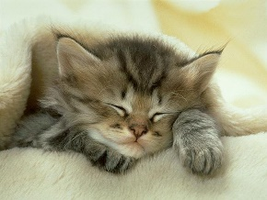
THE SONG FAT CAT MAT LISTEN:
I GOT A CAT, WHO WEARS A WHITE HAT. I GOT A CAT, WHO LIKES IT LIKE THAT. I GOT A CAT, WHO LIES ON A MAT. HE‘S SUCH A FAT CAT. HE LIKES IT LIKE THAT. I GOT A CAT, WHO LOOKS LIKE A RAT. I GOT A CAT, WHO CAN SWING A BAT. I GOT A CAT, WHO PURRS LIKE A BRAT, WHEN THAT CAT DOESN‘T GET HIS SNACK. THAT‘S MY CAT, MAT. HE‘S A REALLY FAT CAT. THAT‘S MY CAT, MAT. HE‘S A REALLY FAT CAT.

Slide 6
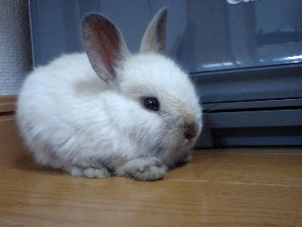
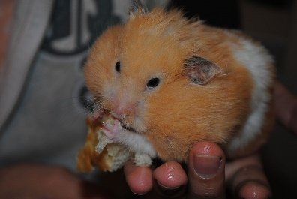
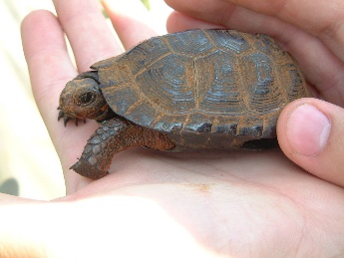
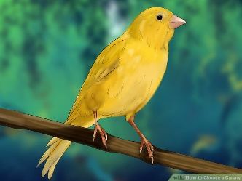
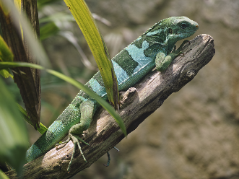
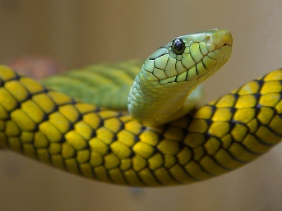
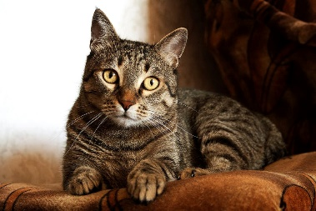
PETS REVISION PREVERJANJE LISTEN:
MATCH. POVEŽI SLIKO Z BESEDO. 5 BESED JE ODVEČ.
A HAMSTER A CANARY A PARROT
A TURTLE A GOLDFISH A DOG A DUCK
A SNAKE A GECKO A CAT A RABBIT AN IGUANA

