Slide 1
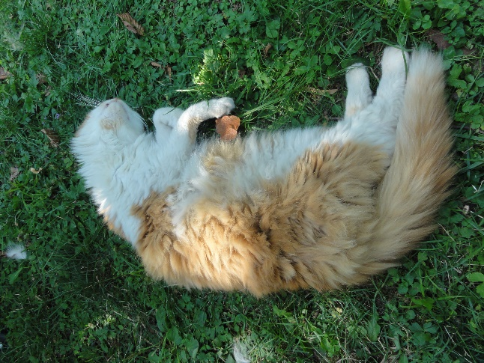
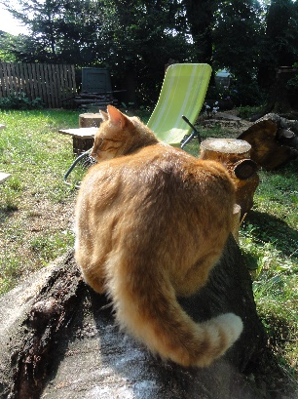
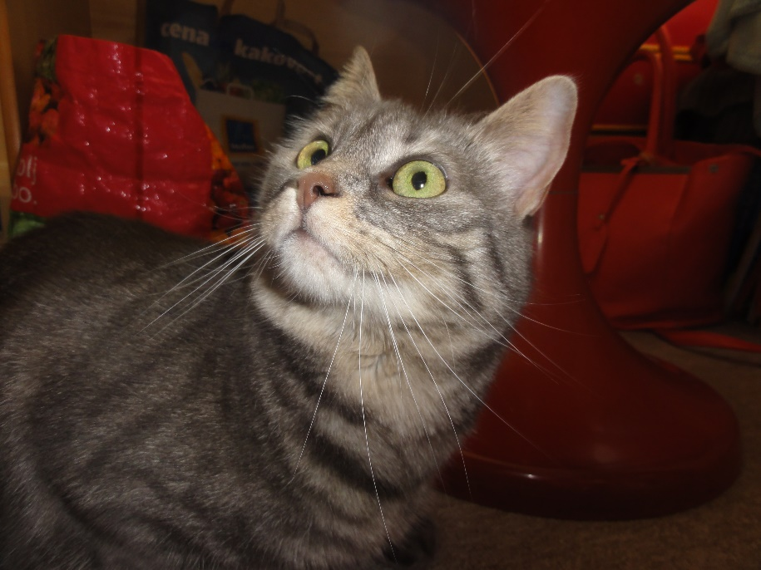
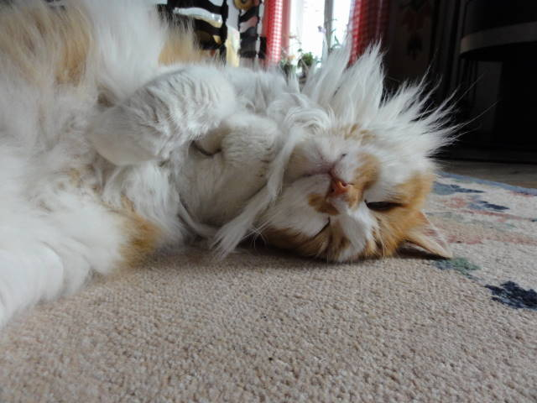
PETS 2. CATS
1.B, 1.D MONTH: MAY WEEK: 37. TEACHER: JOLANDA REGOUC

Slide 2
CAT FAT MAT REPEAT THE SONG PONOVI PESEM

Slide 3
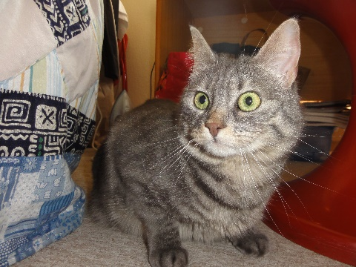
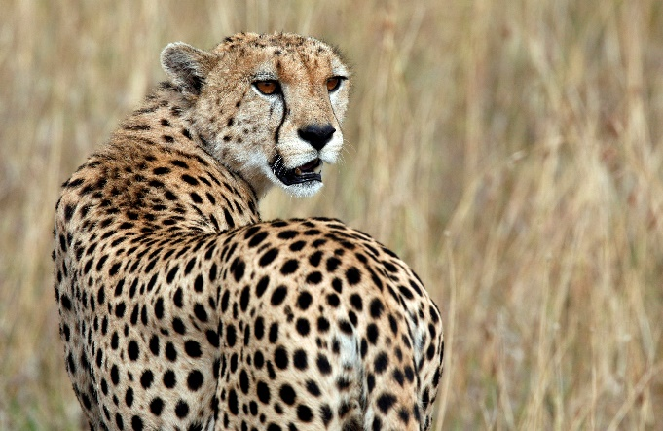
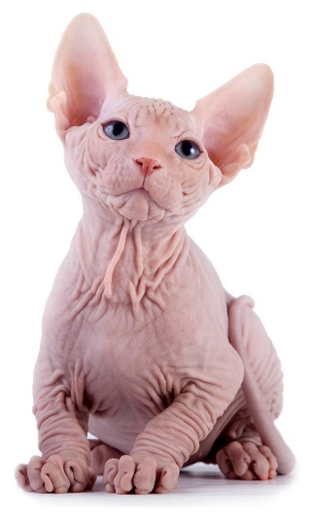
A CAT BIG, SMALL VELIK, MAJHEN LISTEN:
A DOMESTIC CAT IS A SMALL CAT. DOMAČI MAČEK JE MAJHEN MAČEK.
A WILD CAT IS A BIG CAT. DIVJI MAČEK JE VELIK MAČEK. A CAT IS FURRY. A CAT HAS GOT SHORT FUR. MAČEK JE KOSMAT. MAČEK IMA KRATKO DLAKO.
SPHYNX CATS HAVE NO FUR. SVINGE NIMAJO DLAKE.
KUKI
LEOPARD
SPHYNX CAT

Slide 4
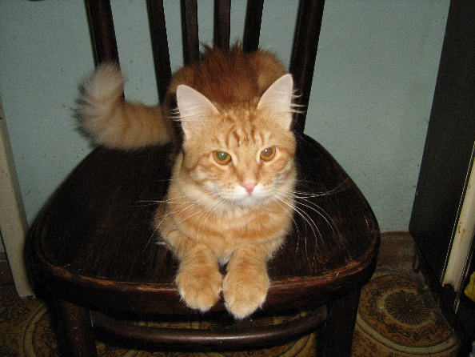
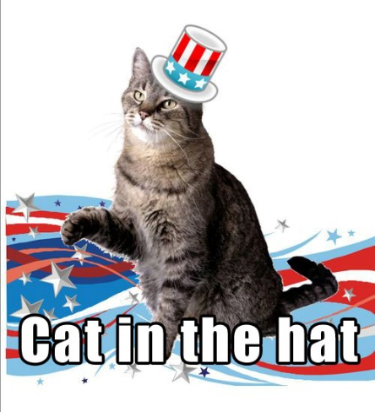
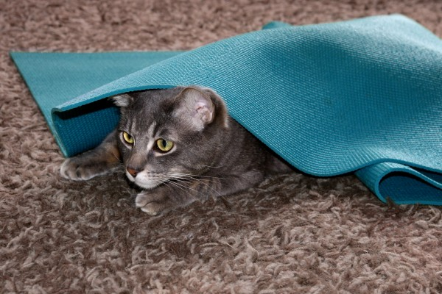
WHERE IS THE CAT? KJE JE MAČEK? LISTEN: ON, IN, UNDER NA, V, POD
WHERE IS THE CAT? THE CHANT IZŠTEVANKA WHERE? WHERE? KJE? KJE?
THE CAT IS ON THE CHAIR. MAČEK JE NA STOLU.
WHERE? WHERE? KJE? KJE?
THE CAT IS IN THE HAT. MAČEK JE V KLOBUKU.
WHERE IS THE CAT? KJE JE MAČEK?
THE CAT IS UNDER THE MAT. MAČEK JE POD TEPIHOM.
WHERE? WHERE? KJE? KJE?
OVER THERE. TAM.
THE CAT ON THE CHAIR
THE CAT UNDER THE MAT

Slide 5
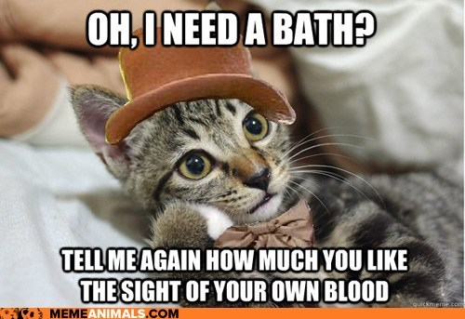
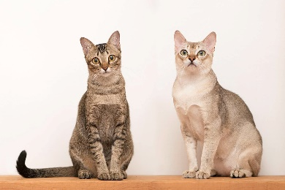
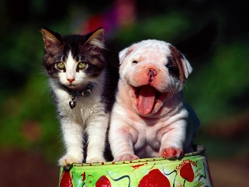
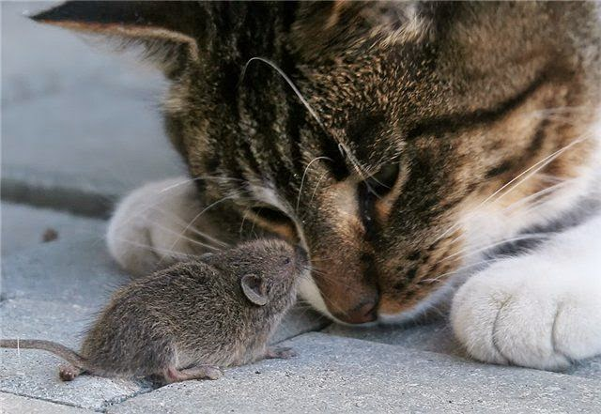
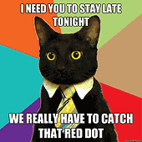
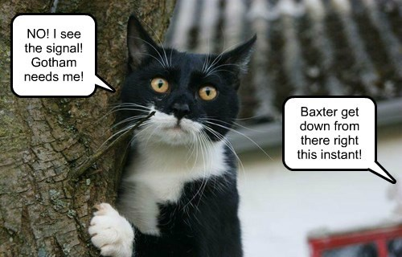
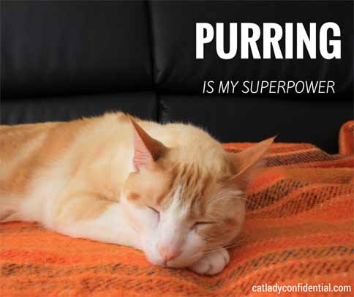
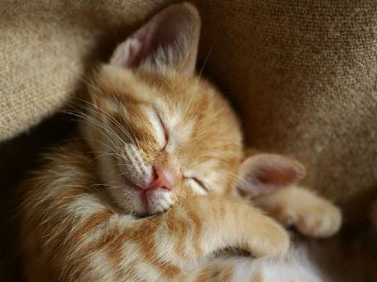
CATS – TEN FACTS ABOUT CATS LISTEN:
1 CATS ARE POPULAR.
2 CATS ARE LUCKY.
3 CATS ARE THE BEST HUNTERS.
4 CATS SAY MEOW.
5 CATS LIKE MICE.
6 THEY ARE CUTE.
7 THEY ARE CLEAN.
8 THEY ARE SLEEPY.
9 THEY PURR.
10 THEY ARE SMART.
A MOUSE = ENA MIŠ MICE = DVE ALI VEČ MIŠI

Slide 6
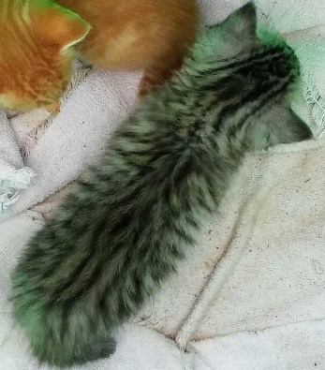
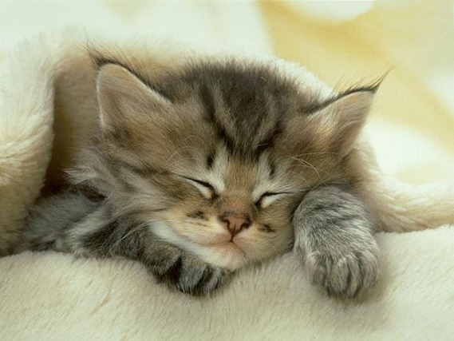
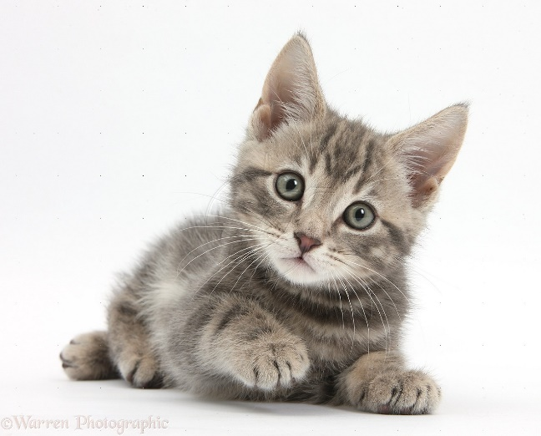
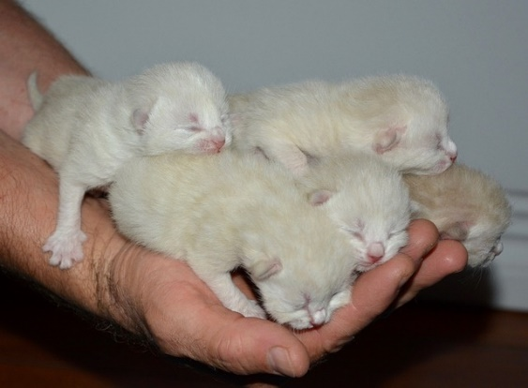
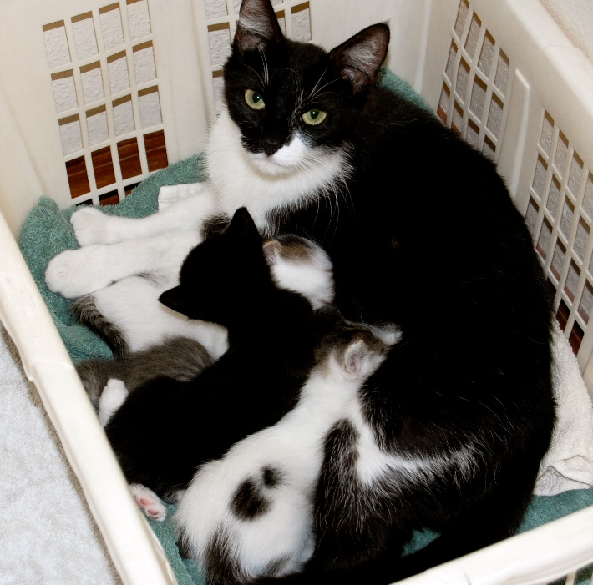
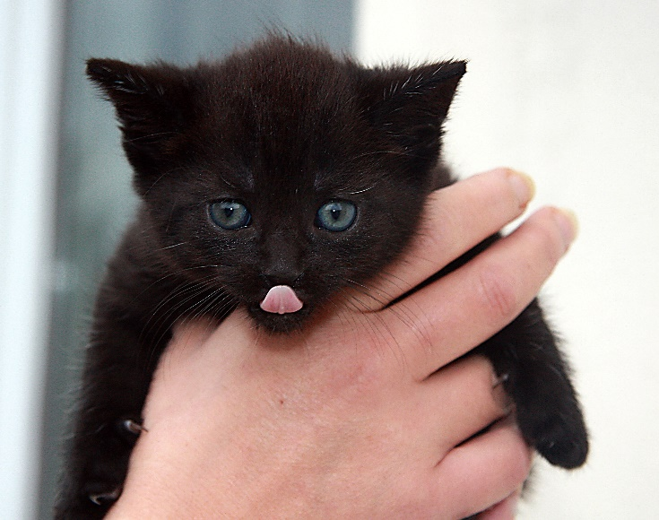
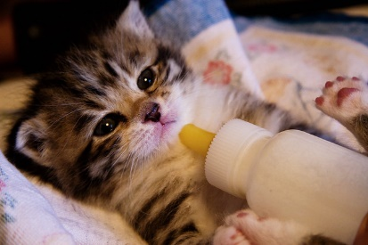
BABY CATS – KITTEN JUST LOOK AT THESE PHOTOS

Slide 7
I LIKE THE FLOWERS REPEAT THE SONG PONOVI PESEM
THE HAPPY END!
THANK YOU!

