Slide 1
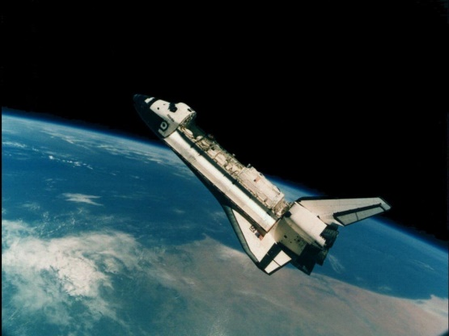
SPACE EXPLORERS 3 SB, 76, 77 AB, 64, 65
5.ab Lessons: 85., 86., 87.
Week: 36. Month: May
Teacher: Jolanda Regouc

Slide 2
Revision 2 Correction (1., 2., 3.task)
Your mistakes are:
1.task: 2 The largest dolphin is an orca (a killer whale). 5 Dolphins use echolocation to find food, navigate the ocean and avoid predators. 9 Some dolphins live about fifty years. 2.task: OK! 3.task: - Is there a station in your town? Yes, there is (a bus station). It‘s next to the school. It‘s in front of the school too. - Is there a big park in your town? Yes, there is. It‘s next to the post office. or: It‘s behind the church. - I like riding a bike, playing football, basketball in the school playground…

Slide 3
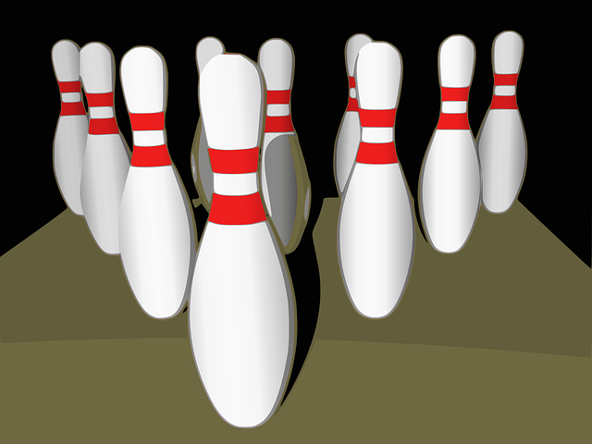
Revision 2 Correction (4., 5., 6. task)
4.task: OK!
5.task: - quarter: Write the word ‚quarter‘ seven times, please. - I go home at twenty past one. (thirteen is wrong)
6. task:
- Talking to friends, ____________, ___________, _______________. - taking photos, ______________, ______________, ______________.
- Playing frisbee, ______________, ______________, _____________. - a skittle = kegelj - playing skittles = kegljanje (SB, 51/3: Now Vineeta and I are playing skittles.)

Slide 4
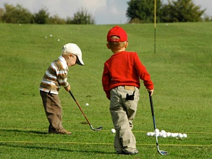
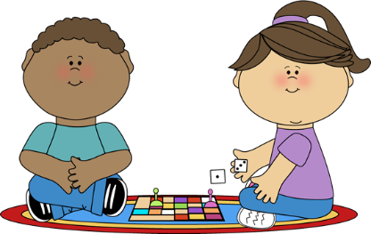
SPACE EXPLORERS 2 SB, 52, 53 Let‘s write
Playing golf
There‘s an alien in front of the bridge.
I like talking to aliens.
Is there a park in your town? No, there isn‘t. There‘s a playground behind the school.
Where‘s my ball? It‘s between the tree and the flowers…in the lake.
Where‘s Jim? Your friend is behind the school.
I‘m hot. Is there a swimming pool in this town? Yes, there is. It‘s opposite the shop.
Oh dear!!!
Playing board games

Slide 5
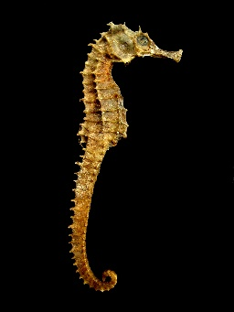
SPACE EXPLORERS 3 Let‘s write, SB, 76, 77 Listen:
The Explorer is at home on Earth.
What‘s your job? We‘re space explorers.
What time do you get up? I get up at quarter past eight.
Let‘s have a look at my spaceship video.
Look! There‘s the sea planet. Let‘s go!
Look over there, in the water!
Oh, no! The seahorses on this planet are very dangerous.
That‘s OK! The sharks on this planet are friendly!
A seahorse

Slide 6
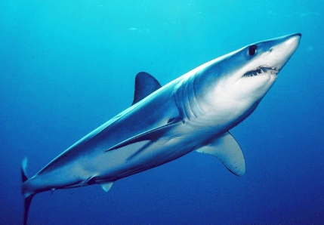
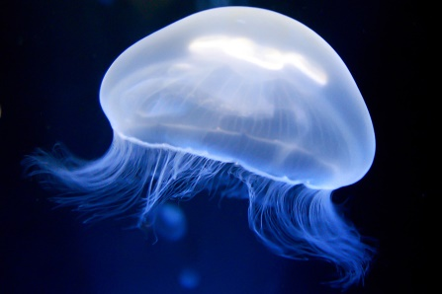
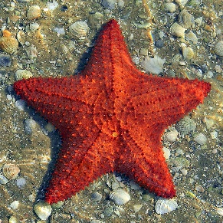
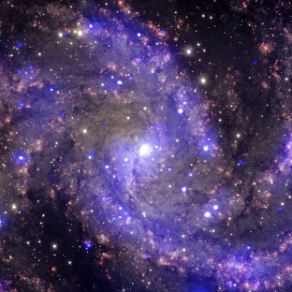
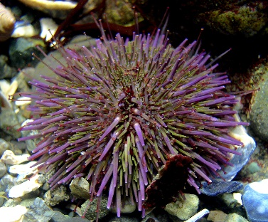
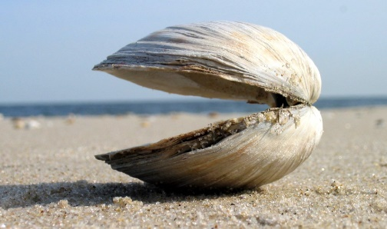
Space explorers 3 SB, 76, 77
LISTEN:
Match: a seahorse a starfish a clam a shark the Galaxy a sea urchin a jellyfish a planet

Slide 7
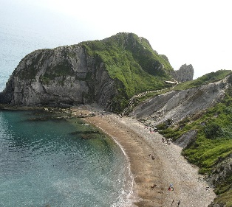
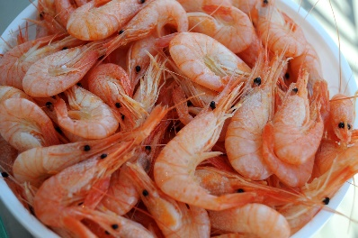
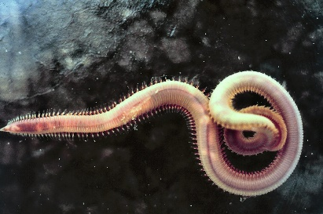
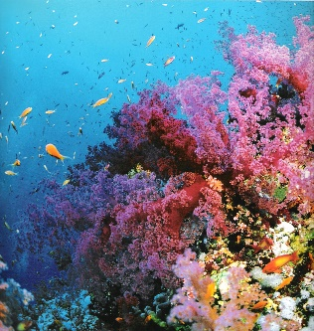
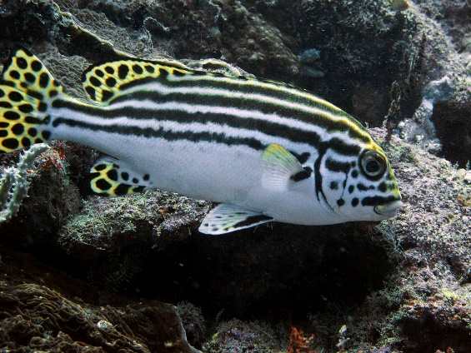
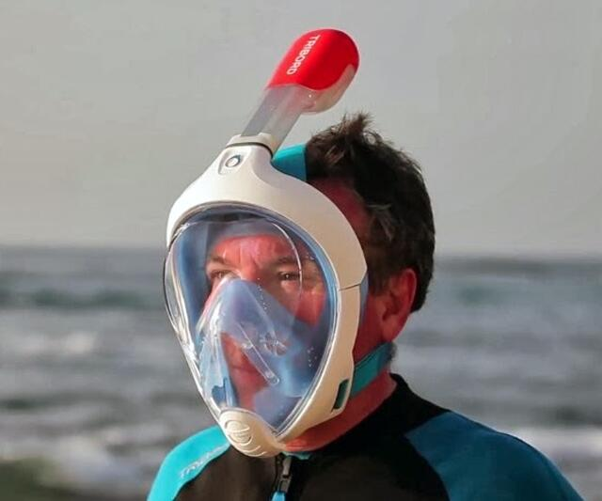
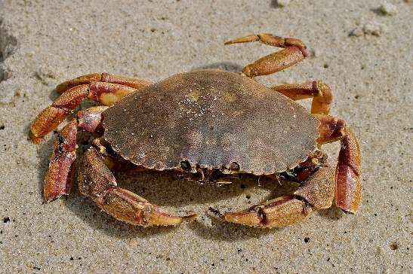
THAILAND SB, 78, 79 Listen:
Write twice (2x): Match words and pictures.
A beach
A snorkel, snorkelling
A mask
A boat
The Andamon Sea
Oriental Sweetlips
Spots
Stripes
Worms
Crabs
Coral
shrimps
Can you see spots and stripes?

