Slide 1
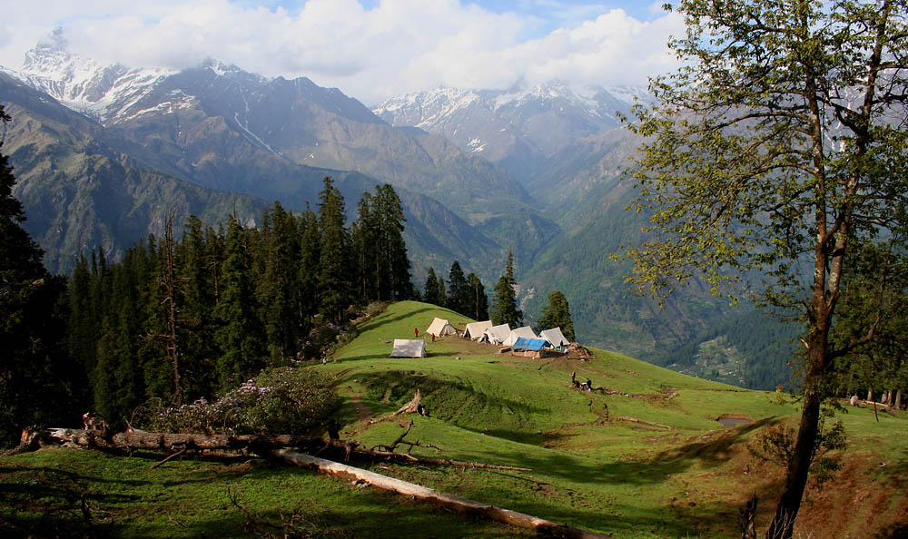
Unit 6: Camping
4.a
May
Week: 39 Lesson: 69., 70.
Teacher: Jolanda Regouc

Slide 2
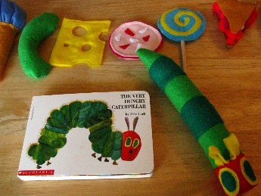
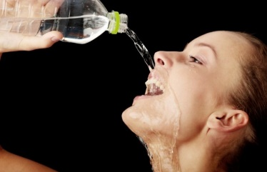
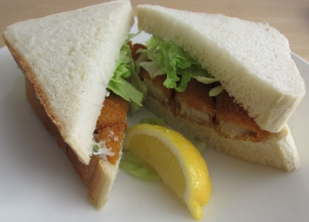
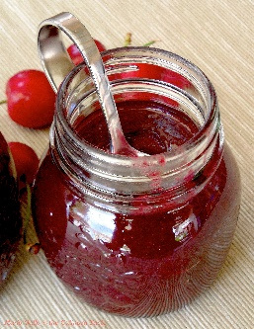
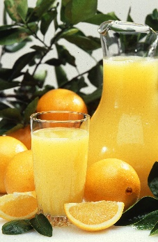
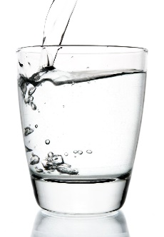
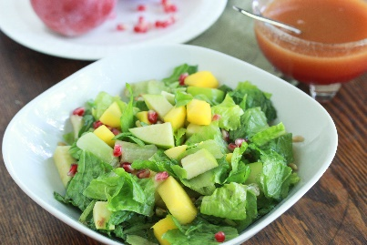
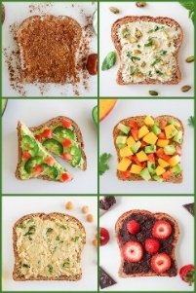
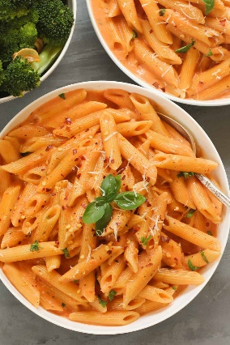
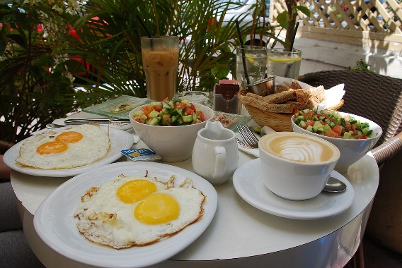
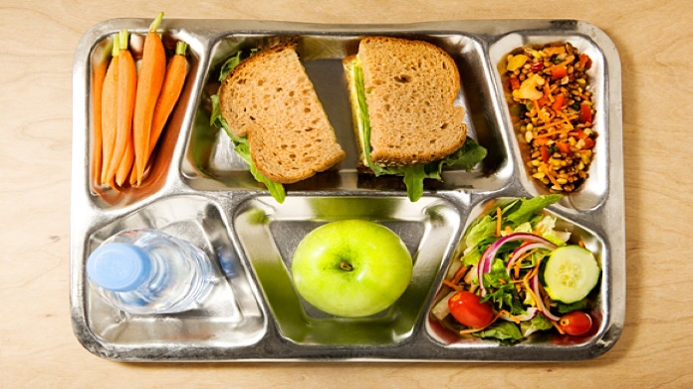
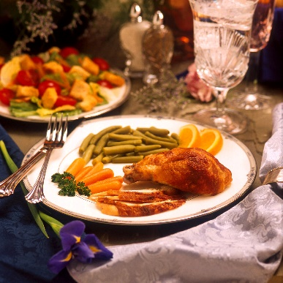
I‘m hungry! I‘m thirsty! Listen:
Salad
Toast
Water
Jam
Sandwiches
Pasta
Eggs
Juice
Breakfast
Lunch
Dinner
Hungry
thirsty

Slide 3
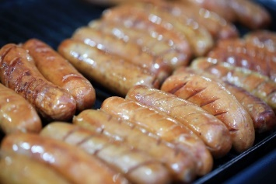
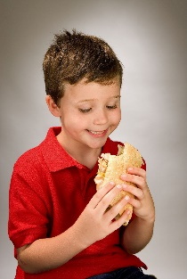
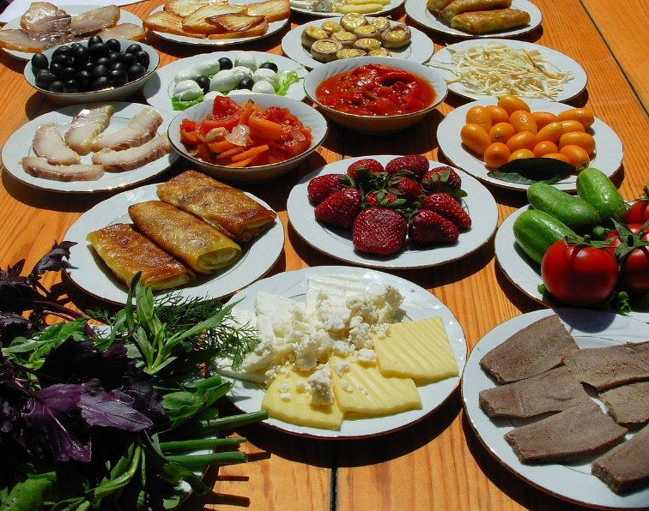
Let‘s eat SB, 70 Listen:
Read and rewrite. Listen:
I‘m hungry. Let‘s eat!
Do you like sausages? Yes, I do.
Do you like juice? No, I don‘t.
Can I have water, please?
Can we have some, please? Sorry, children. This food is just for Mike and me.
Remember: Do you like salad? Yes, I do. / No, I don‘t.

Slide 4
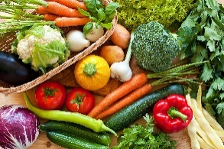
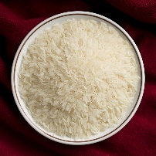
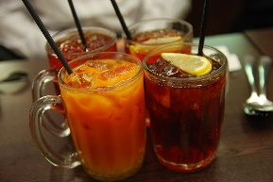
Mr Munch SB, 71 Listen:
Read, repeat and rewrite words (three times, 3x):
1 breakfast ____________________________________________
2 lunch________________________________________
3 dinner__________________________________________
4 rice ____________________________________
5 vegetables___________________________________________
6 ham _________________________________
7 food __________________________________________
8 drink _______________________________________

Slide 5
Do you like broccoli? yes, I do! Let‘s watch the video!

Slide 6
SB, 72/2.:Read and listen. Write Sam or Sophie Listen:
1 I have eggs for breakfast and ham for dinner. ______________
2 I have pasta for dinner. ______________
3 I have chicken for lunch and I don‘t have vegetables for dinner.__________
4 I have a sandwich and salad for lunch. _________
5 I have toast for breakfast and chicken for lunch. I have water too. ______________
6 I don‘t have toast for breakfast. I have ham and vegetables for dinner.
______________

Slide 7
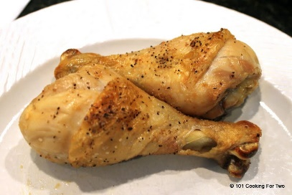
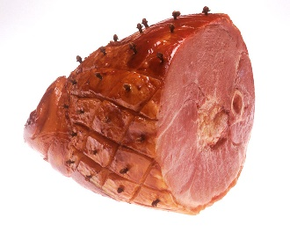
AB, 57, 58, 59 Let‘s open your AB, read and write!
1. AB, 57/2. Write. Then tick or cross. Ask a friend and tick or cross.
Words: water, toast, eggs, salad, pasta 2. AB, 58/1. Read and circle.
58/2. Write. Do you like juice? No, _______
3. AB, 59/1. Write the number (1-12) 59/2. Which food is not in the song: Circle above./Obkroži zgoraj. 59/3. Find and circle. Write. vegetables, rice, dinner, ham, toast, chicken

Slide 8
Just for you!
Have a nice 39. week!

