Slide 1
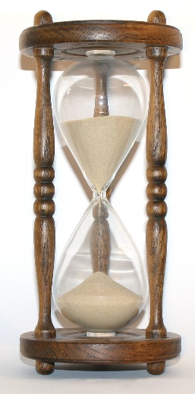
WHO AM I? WHAT TIME IS IT?
3.a, 3.d
Month: MAY Week: 37. Teacher: Jolanda Regouc

Slide 2
Who am I? ..\who-am-i_15635.doc
1. Listen:
2. Write. / Napiši.
1 a street sweeper 2 a nurse 3 a teacher 4 a mechanic 5 a cook 6 an engineer 7 a doctor 8 a tailor 9 a pilot 10 a painter 11 a policeman 12 a barber 13 a waiter

Slide 3
What time is it? Listen:
Odpri dokument, ki ima 6 strani in 5 nalog, ki so povezane s časom. telling-time-half-past-a-quarter-past-a-quarter-to-fun-activities-games-grammar-drills_119380.docx
1. Look and match./Poglej, preberi in poveži. 2. Stick the pictures and answer the questions with ‚Yes, it is‘, OR ‚No, it isn‘t‘./Nalepi slike ur s 6. strani in napiši pravilen odgovor. 3. Draw the time./ Nariši čas (ure s kazalci). 4. Write the time. /Napiši, koliko je ura. 5. Write the time in numbers. /Napiši čas s številkami (digitalna ura). 6. Cut and stick. /Odreži nalepi (naloga 2.)

Slide 4
Repeat / Ponovi Listen:
1. Write./Napiši v zvezek.
a quarter, a quarter,
a quarter, a quarter.
6.45: It‘s a quarter to seven. 7.15: It‘s a quarter past seven. 8.15: It‘s a quarter past eight. 9.45: It‘s a quarter to ten. 4.45: It‘s a quarter to five.
2. Write./ Napiši v zvezek.
Half, half, half, half, half, half, half, half, half, half.
10.30: It‘s half past ten. 11.30: It‘s half to twelve. 12.30: It‘s half past twelve. 1.30: It‘s half to two. 3.30: It‘s half past three.

Slide 5
Worksheets /UL Kdor želi še več!
..\whats-the-time-game-fun-activities-games_17133 (1).ppt
what-time-is-it_8343.doc
what-time-is-it_9373.doc easy.doc

